Slide 1

Dirección de mantenimiento de bienes e intendencia

Slide 2
Cesar Gradilla Flores
Director de mantenimiento de bienes e intendencia

Slide 3
OCTUBRE

Slide 4
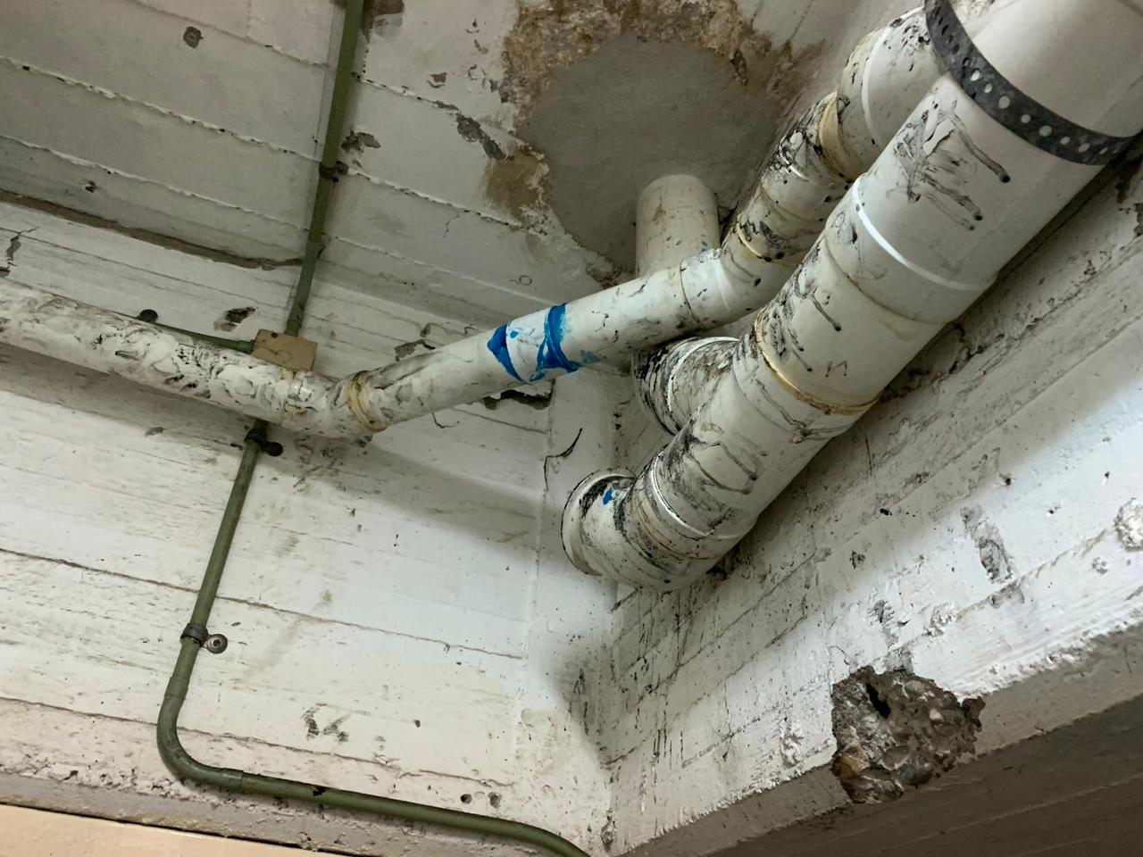
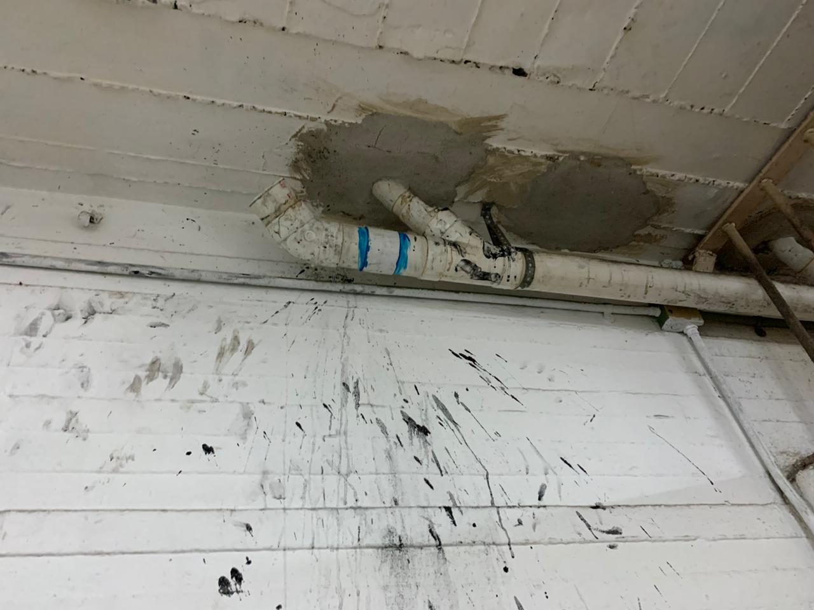
Baños publicos reparacion de fontaneria
A
B
C
D
Analysis of
teaching
Teaching
strategy
The teaching
process

Slide 5
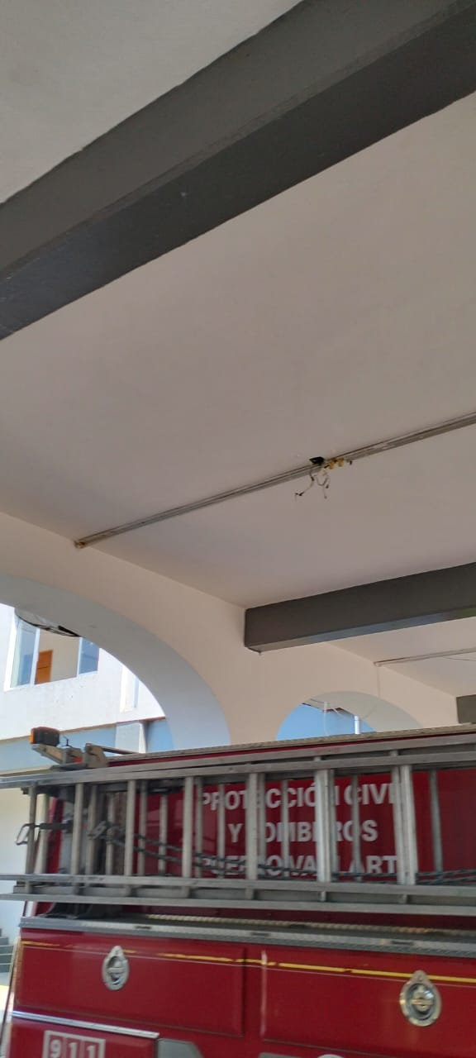
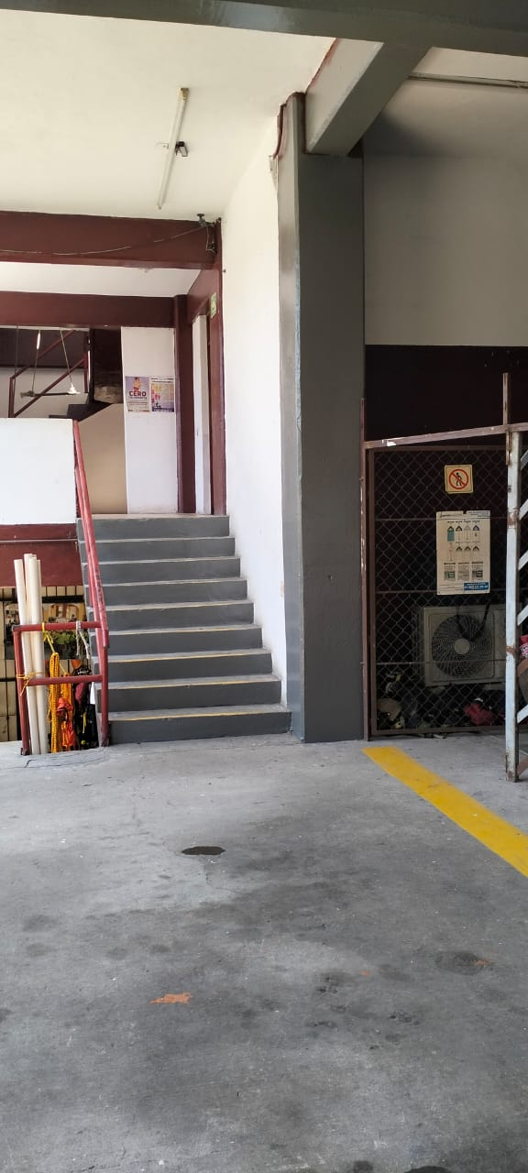
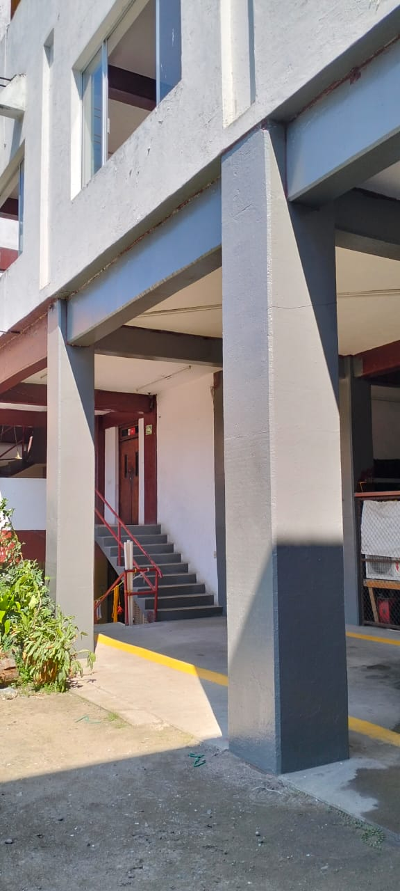
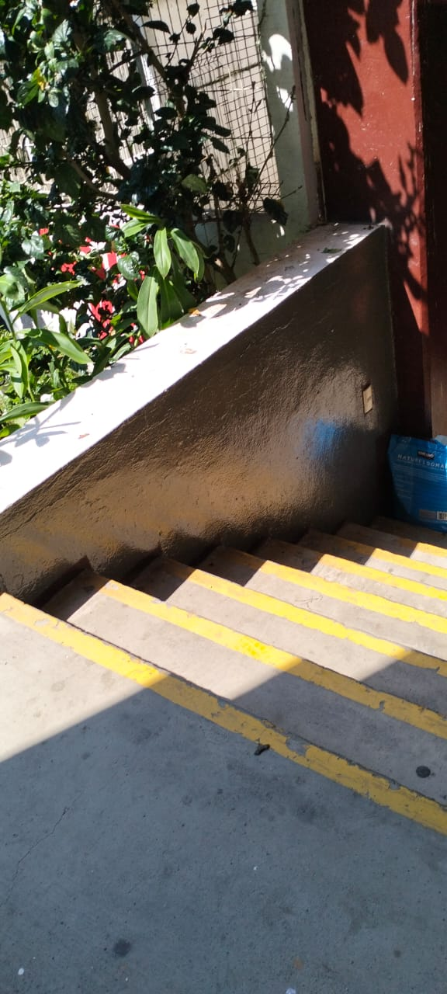
Base central de Bomberos trabajos de pintura
A
B
C
D
Analysis of
teaching
Teaching
strategy
The teaching
process

Slide 6
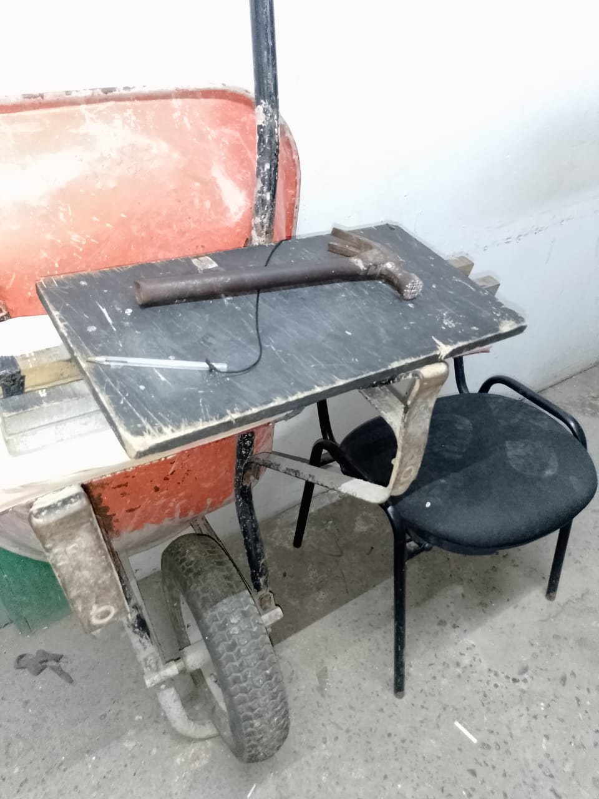
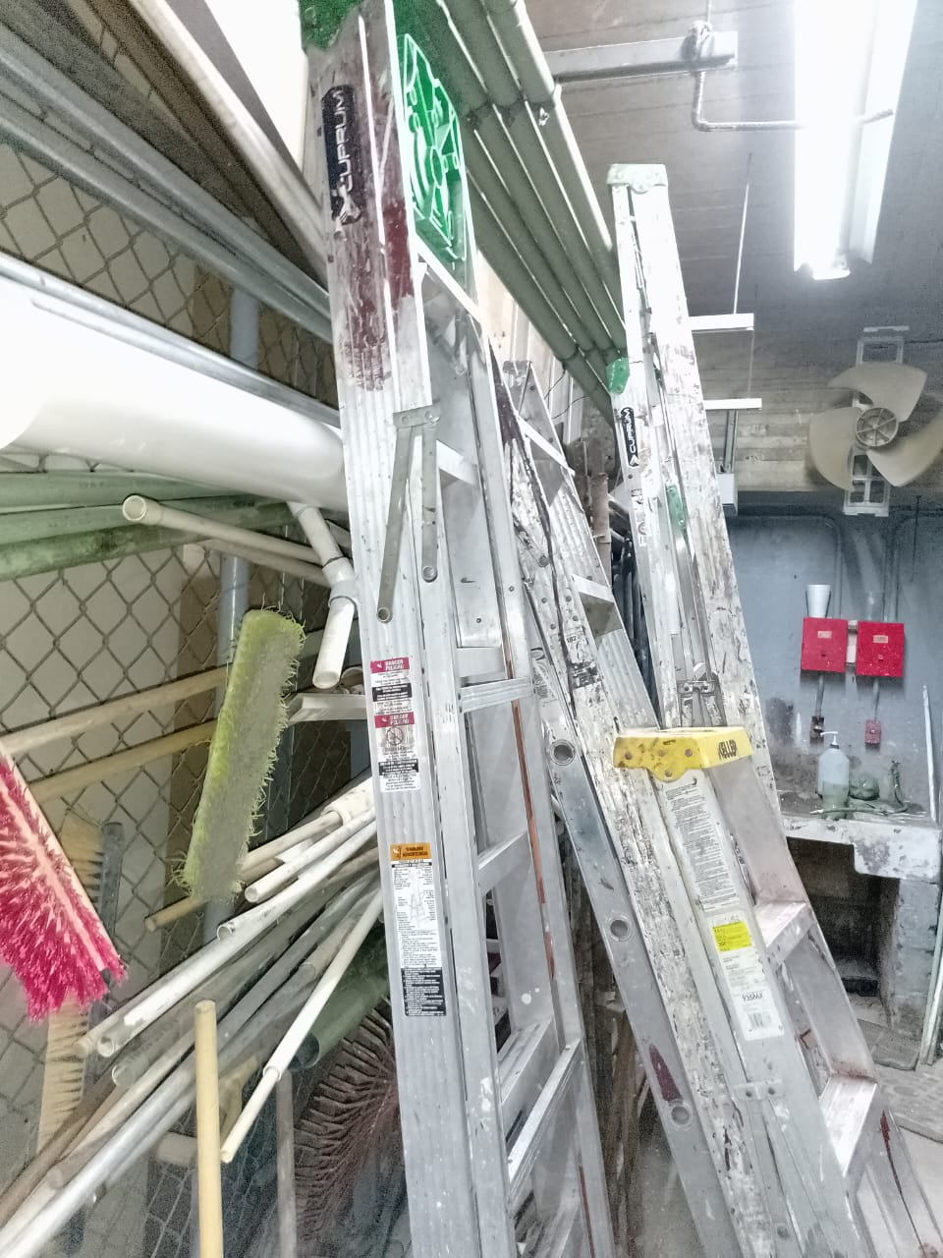
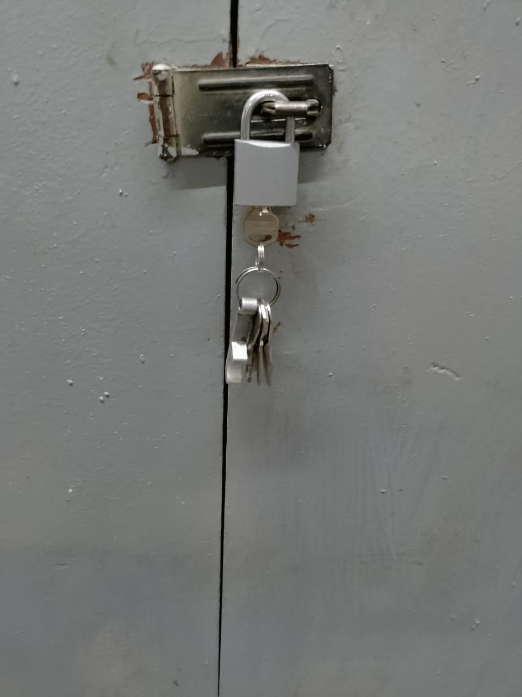
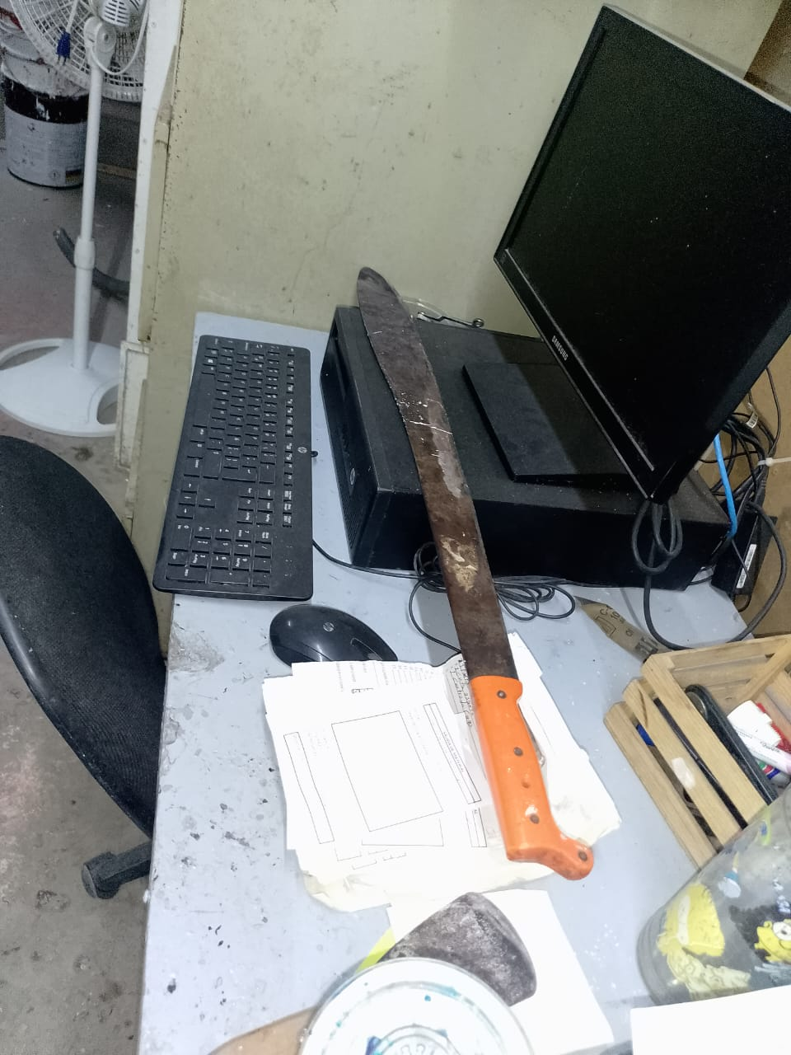
Material Octubre
A
B
C
D
Analysis of
teaching
Teaching
strategy
The teaching
process

Slide 7


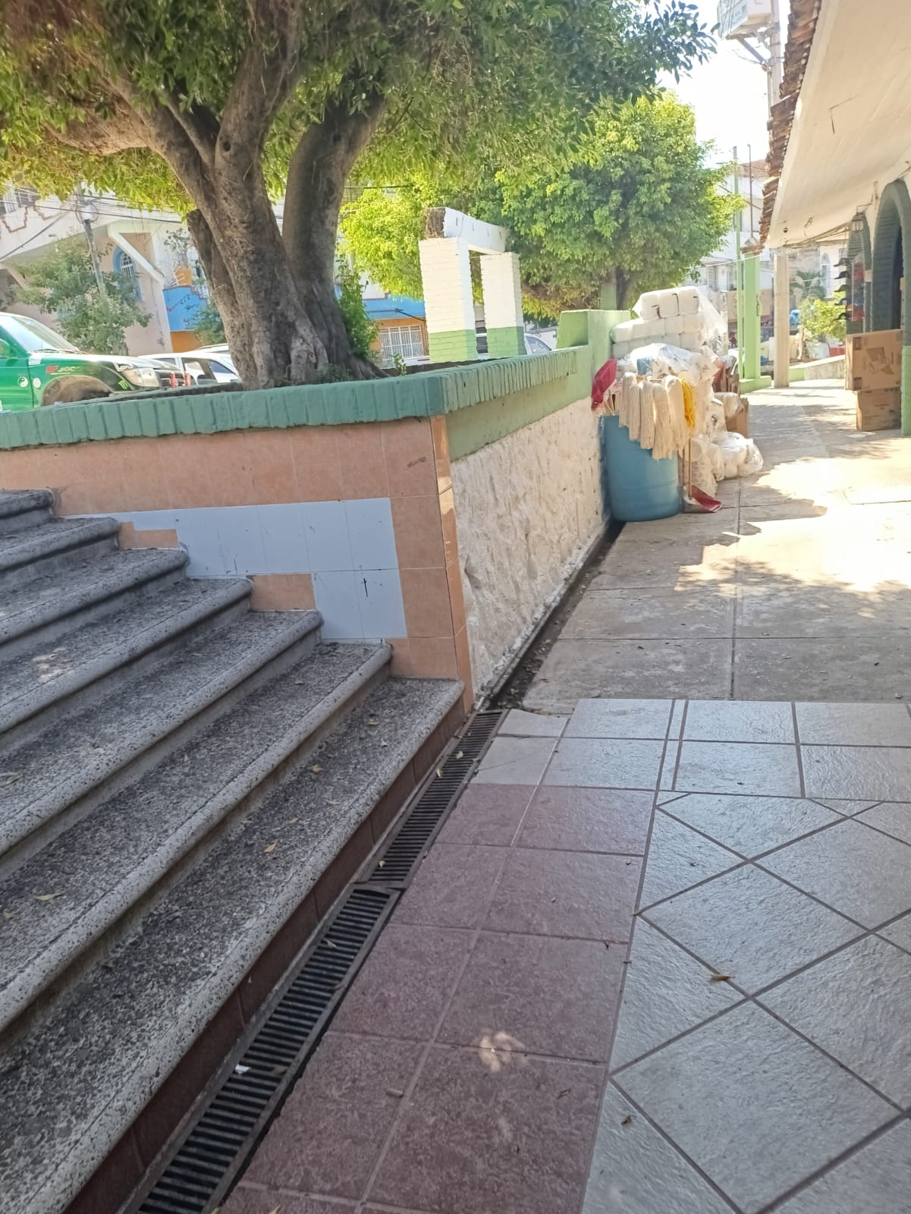
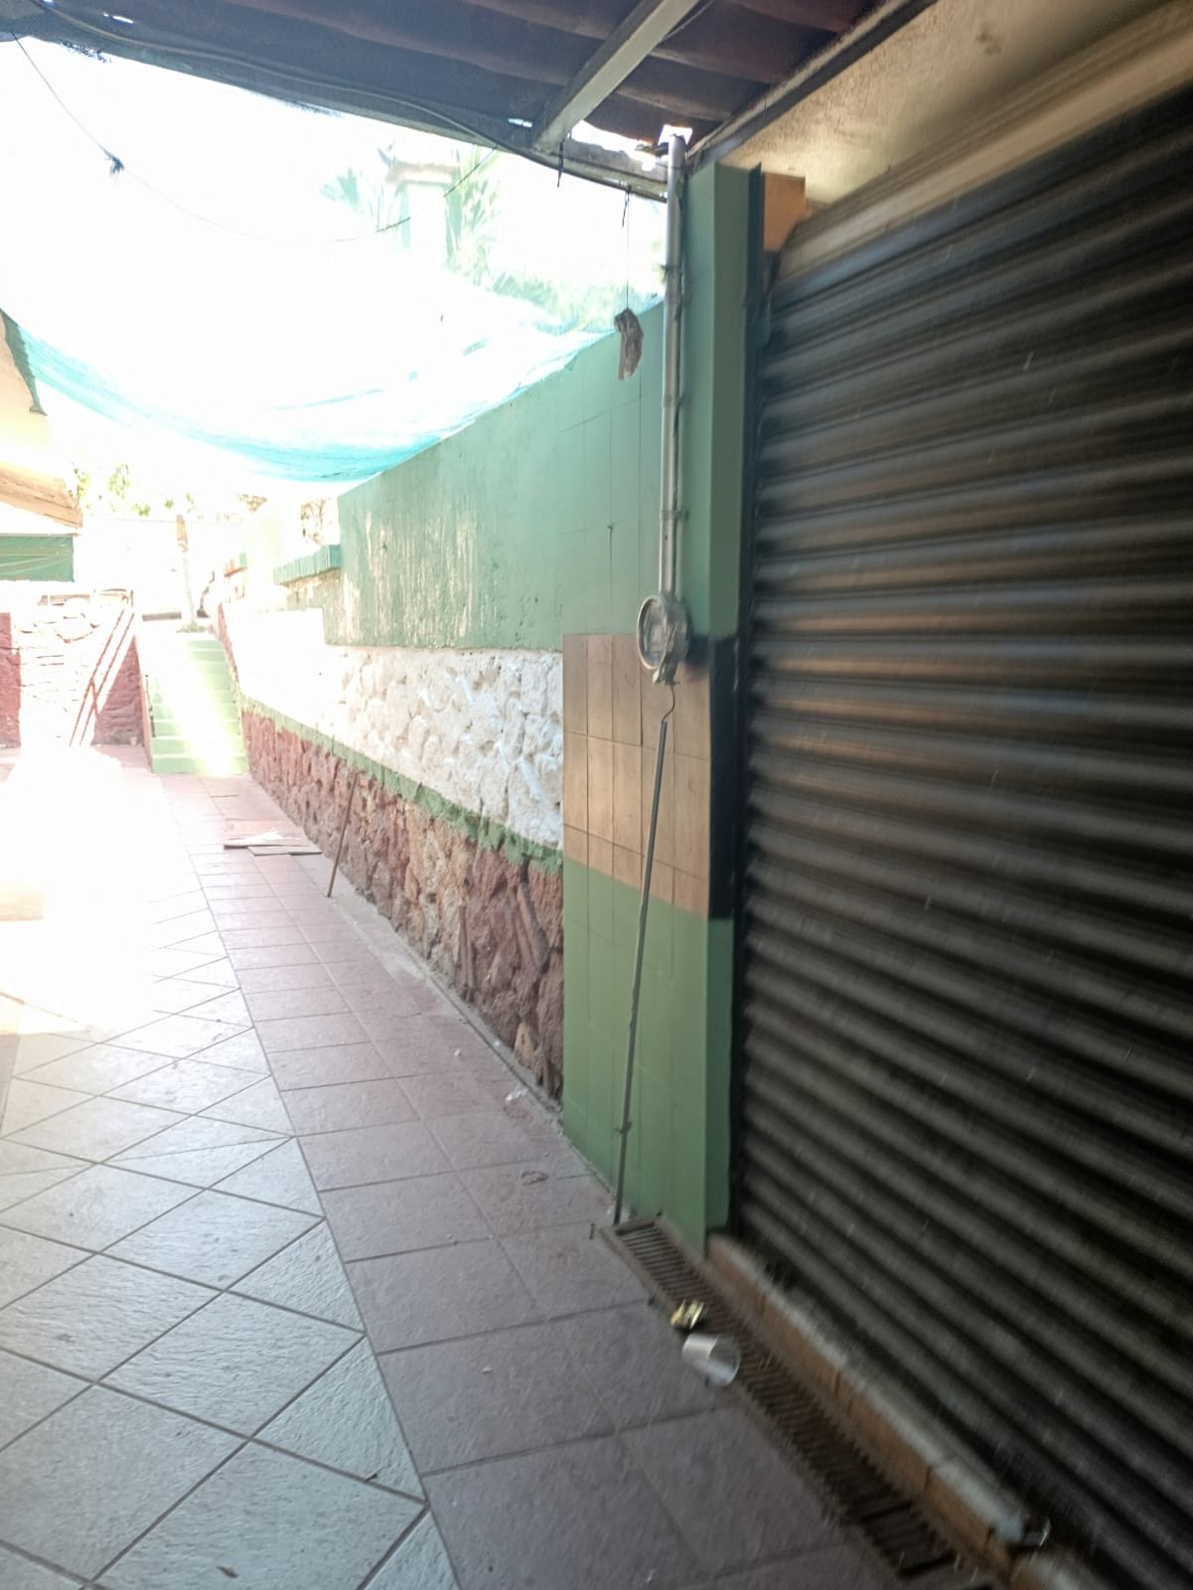
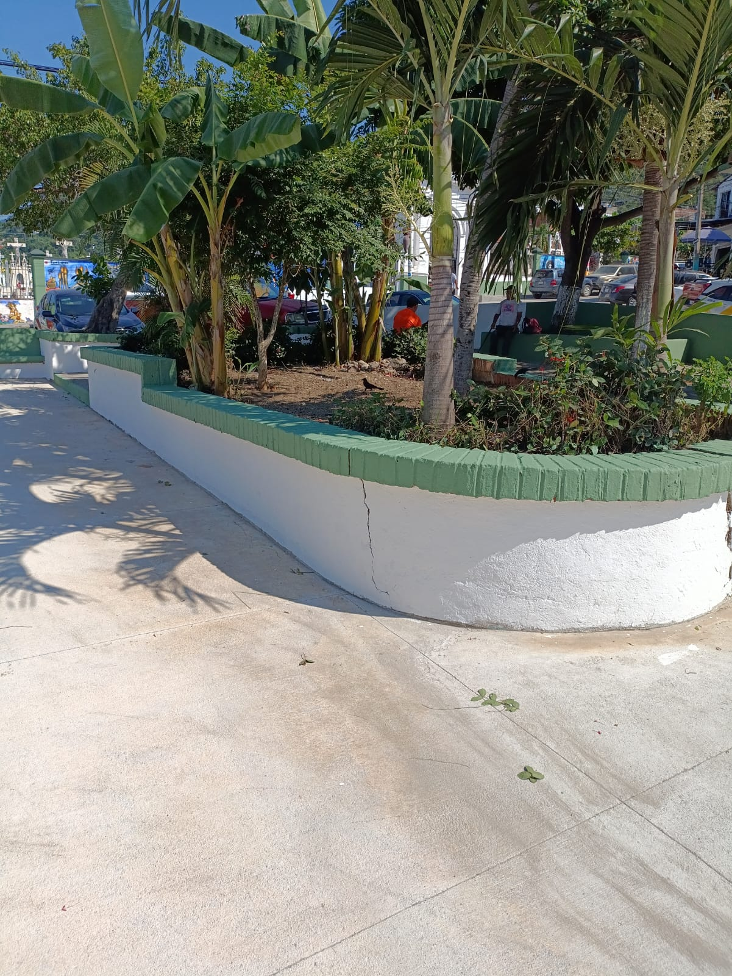
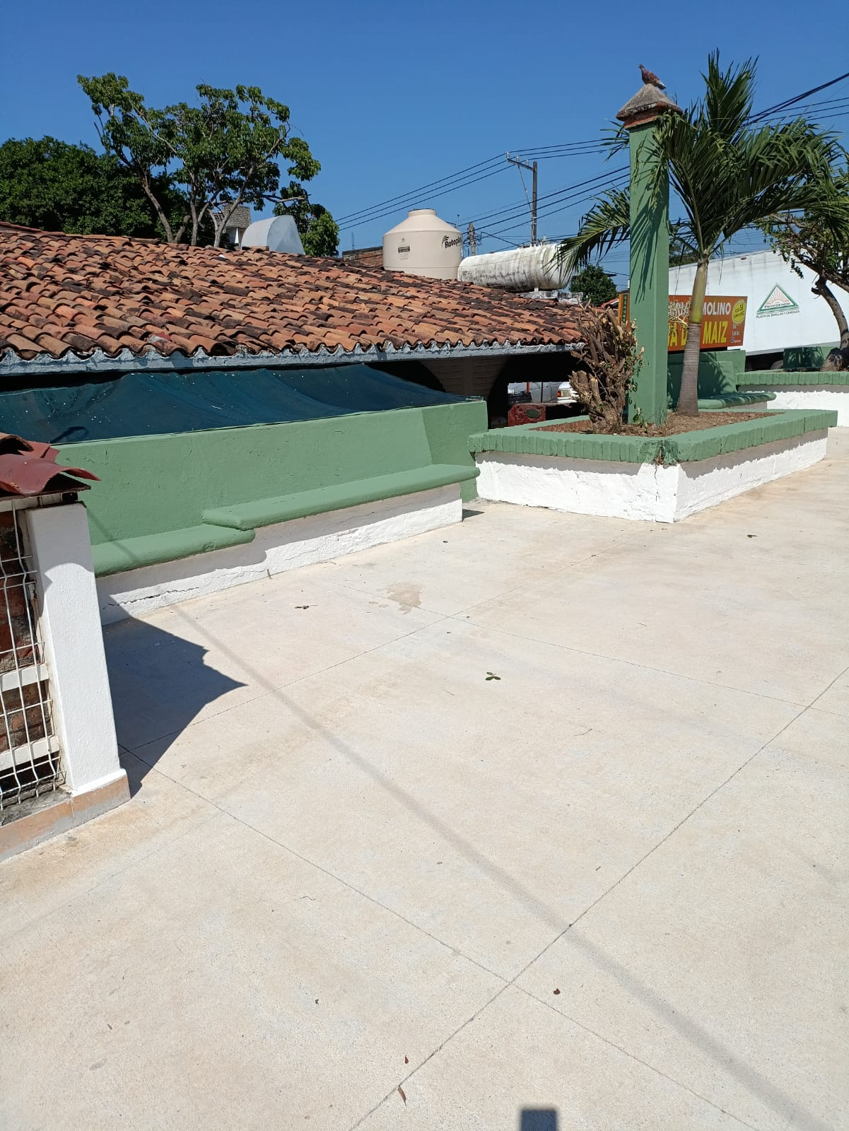
Mercado 5 Diciembre Pintura
Title text addition
Title text addition
Title text addition
Title text addition
The user can demonstrate on a projector or computer, or print the presentation and make it film
The user can demonstrate on a projector or computer, or print the presentation and make it film
The user can demonstrate on a projector or computer, or print the presentation and make it film
The user can demonstrate on a projector or computer, or print the presentation and make it film

Slide 8
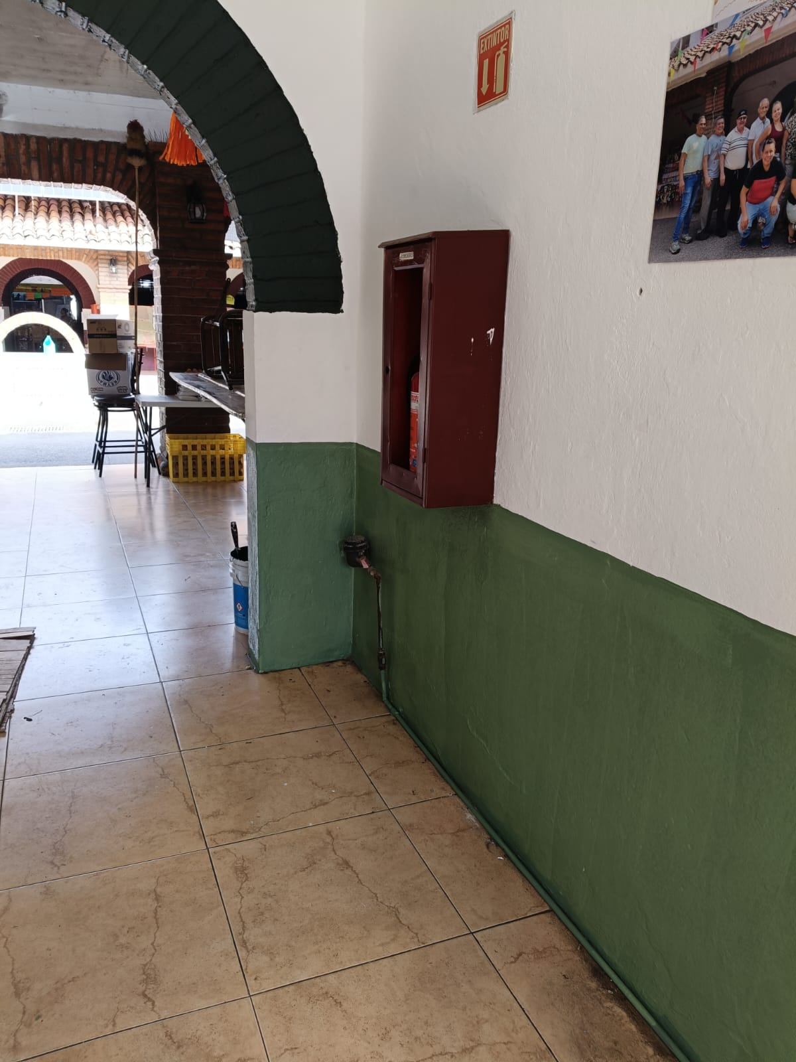
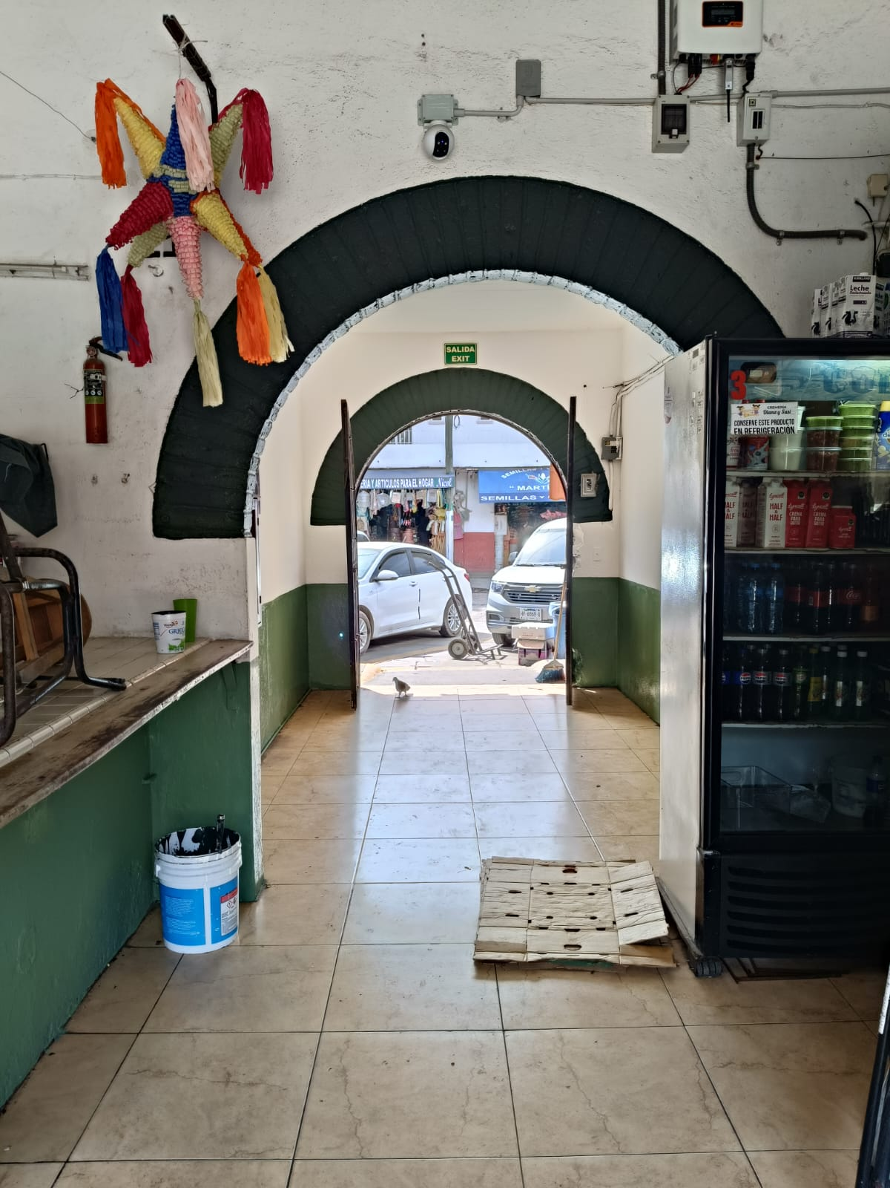
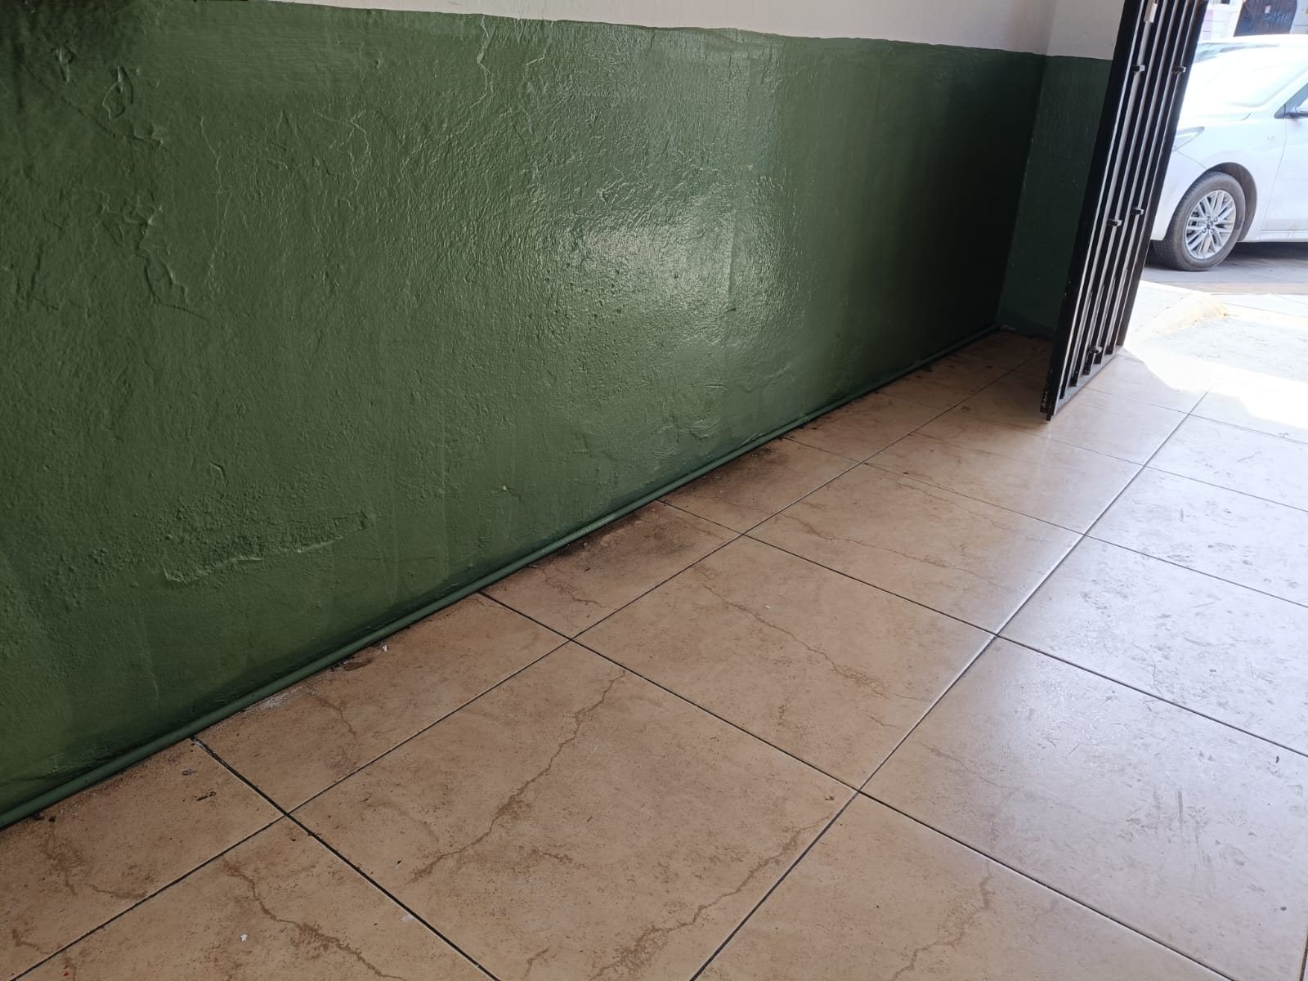
Mercado Emiliano Zapata
Title text addition
Title text addition
Title text addition
Title text addition
The user can demonstrate on a projector or computer, or print the presentation and make it film
The user can demonstrate on a projector or computer, or print the presentation and make it film
The user can demonstrate on a projector or computer, or print the presentation and make it film
The user can demonstrate on a projector or computer, or print the presentation and make it film

Slide 9
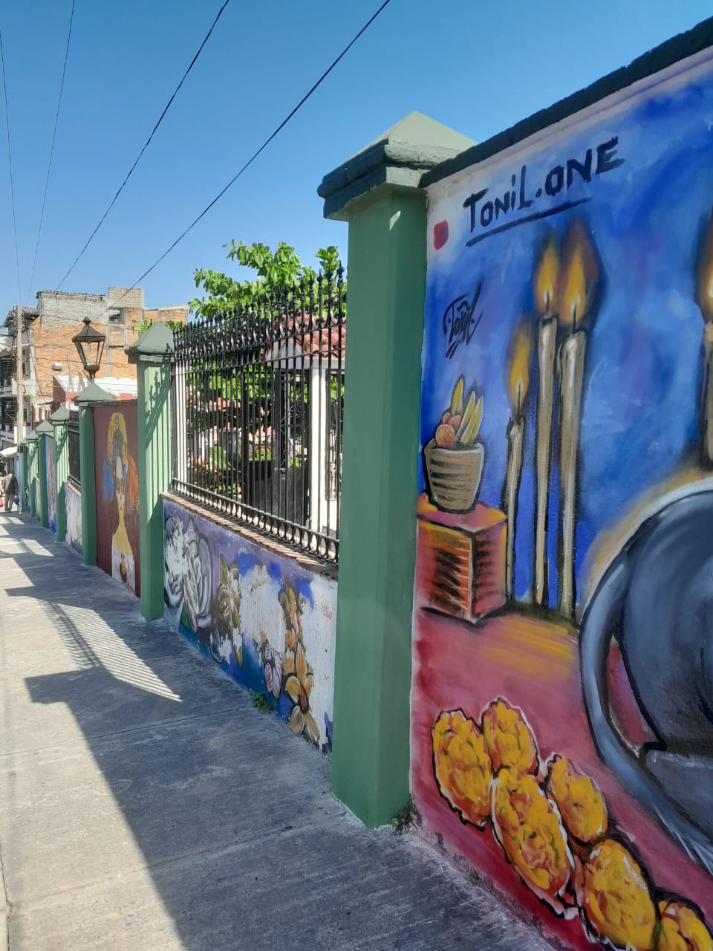
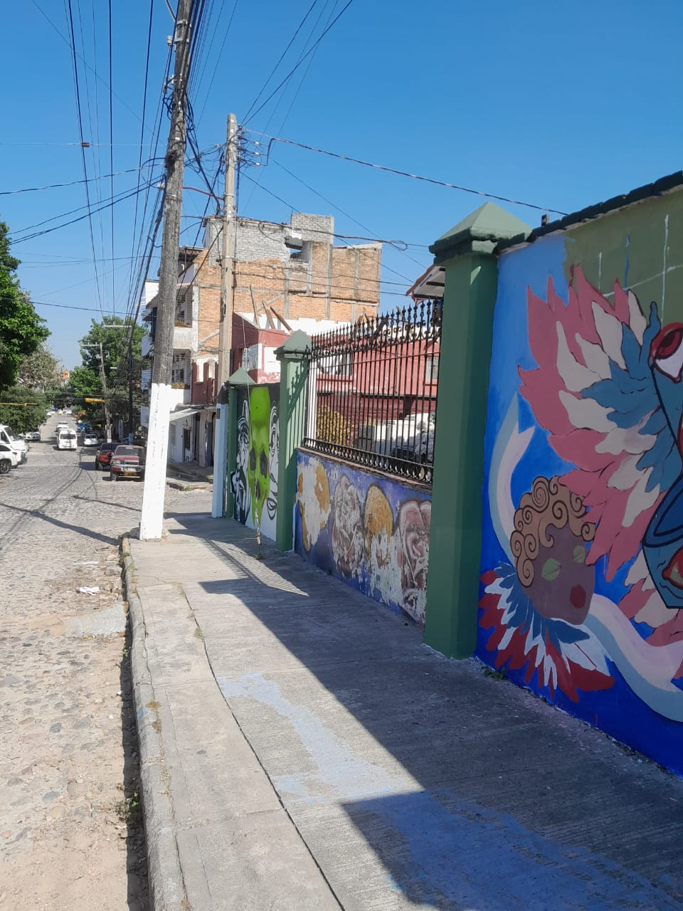
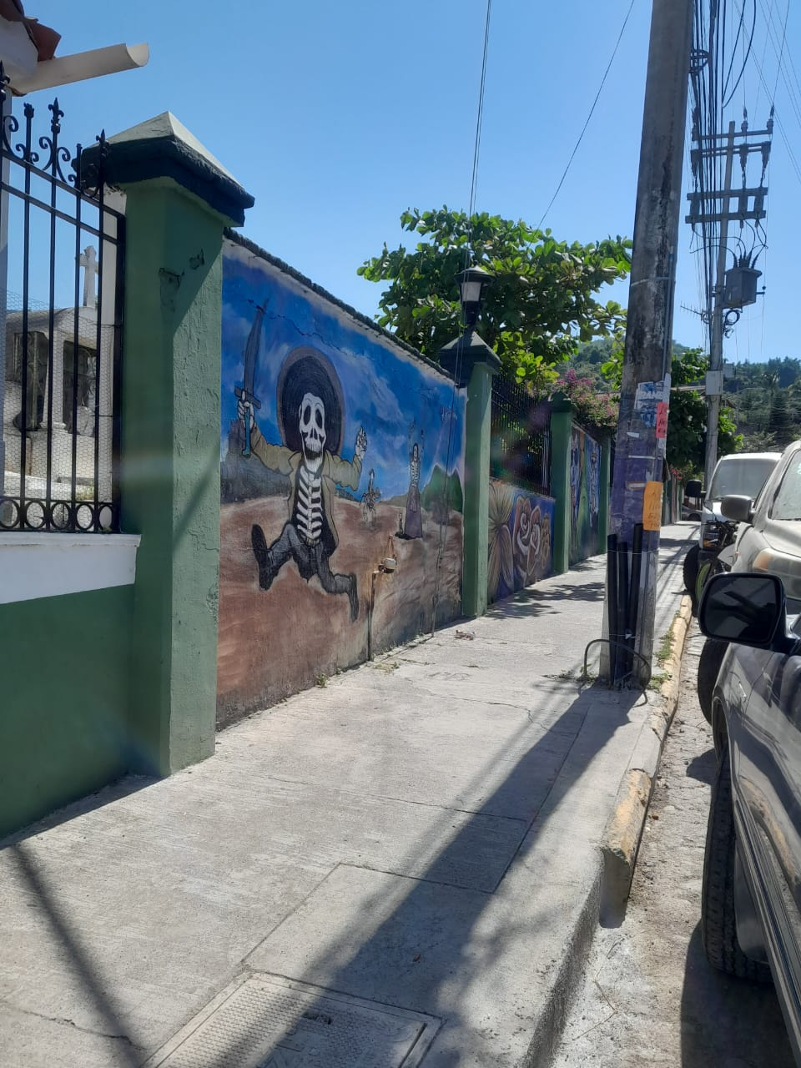
Panteon 5 de Diciembre
Title text addition
Title text addition
Title text addition
Title text addition
The user can demonstrate on a projector or computer, or print the presentation and make it film
The user can demonstrate on a projector or computer, or print the presentation and make it film
The user can demonstrate on a projector or computer, or print the presentation and make it film
The user can demonstrate on a projector or computer, or print the presentation and make it film

Slide 10
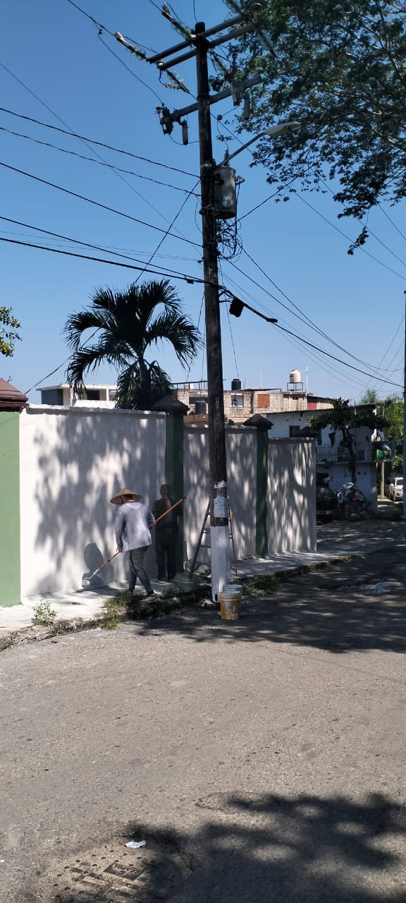
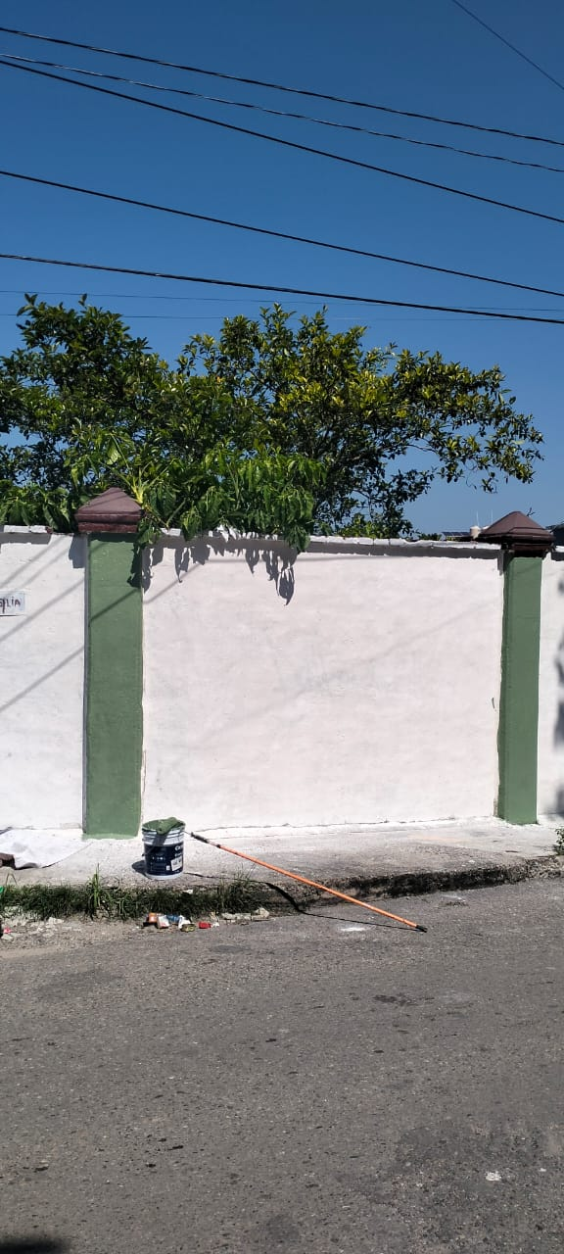
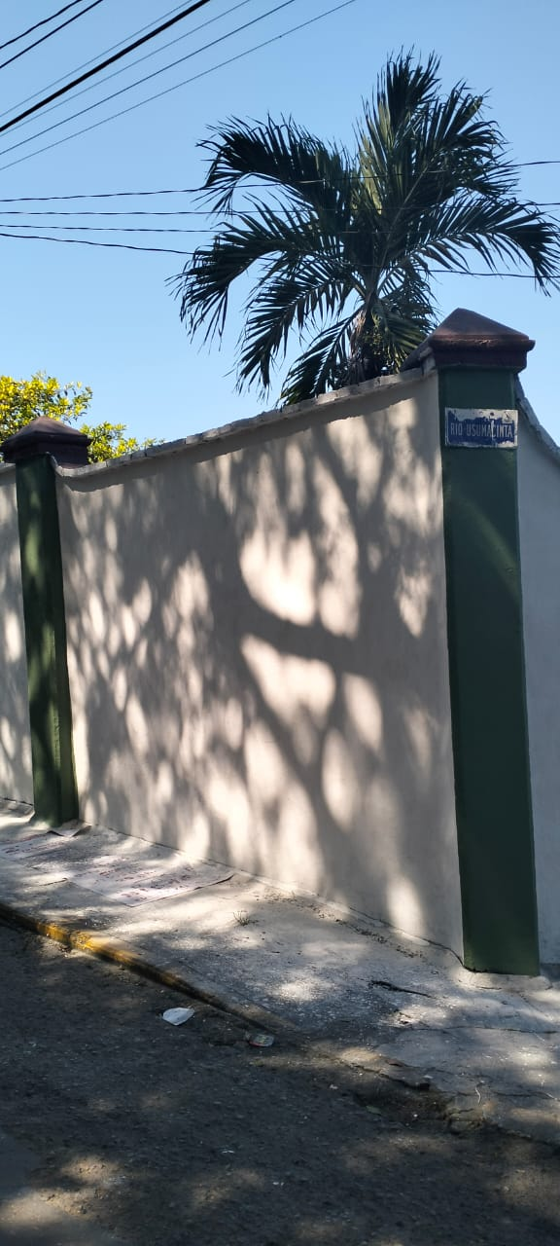
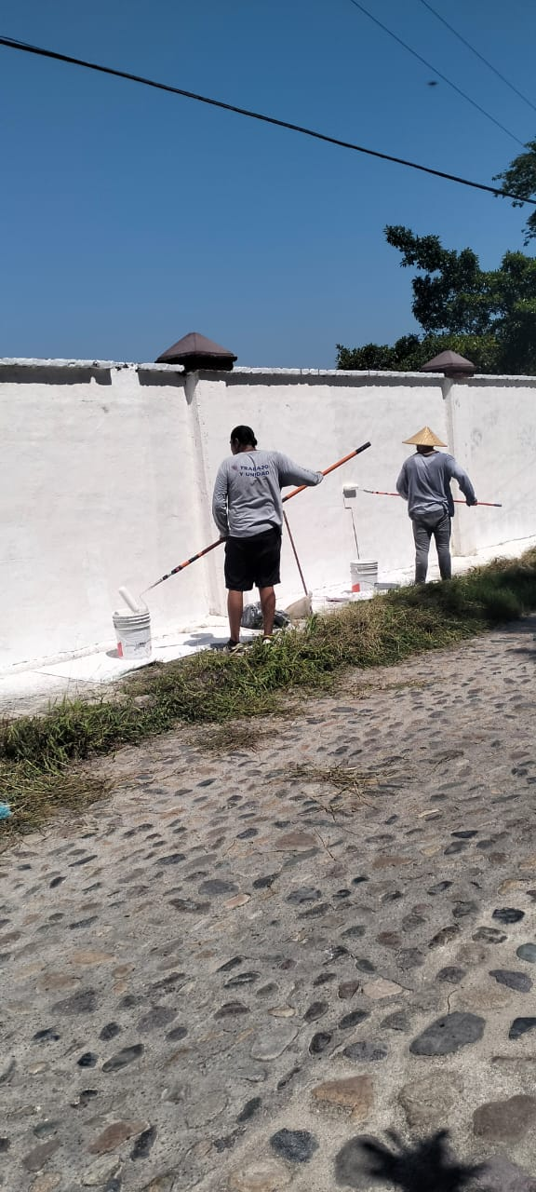
Panteon 5 de Diciembre
Title text addition
Title text addition
Title text addition
Title text addition
The user can demonstrate on a projector or computer, or print the presentation and make it film
The user can demonstrate on a projector or computer, or print the presentation and make it film
The user can demonstrate on a projector or computer, or print the presentation and make it film
The user can demonstrate on a projector or computer, or print the presentation and make it film

Slide 11
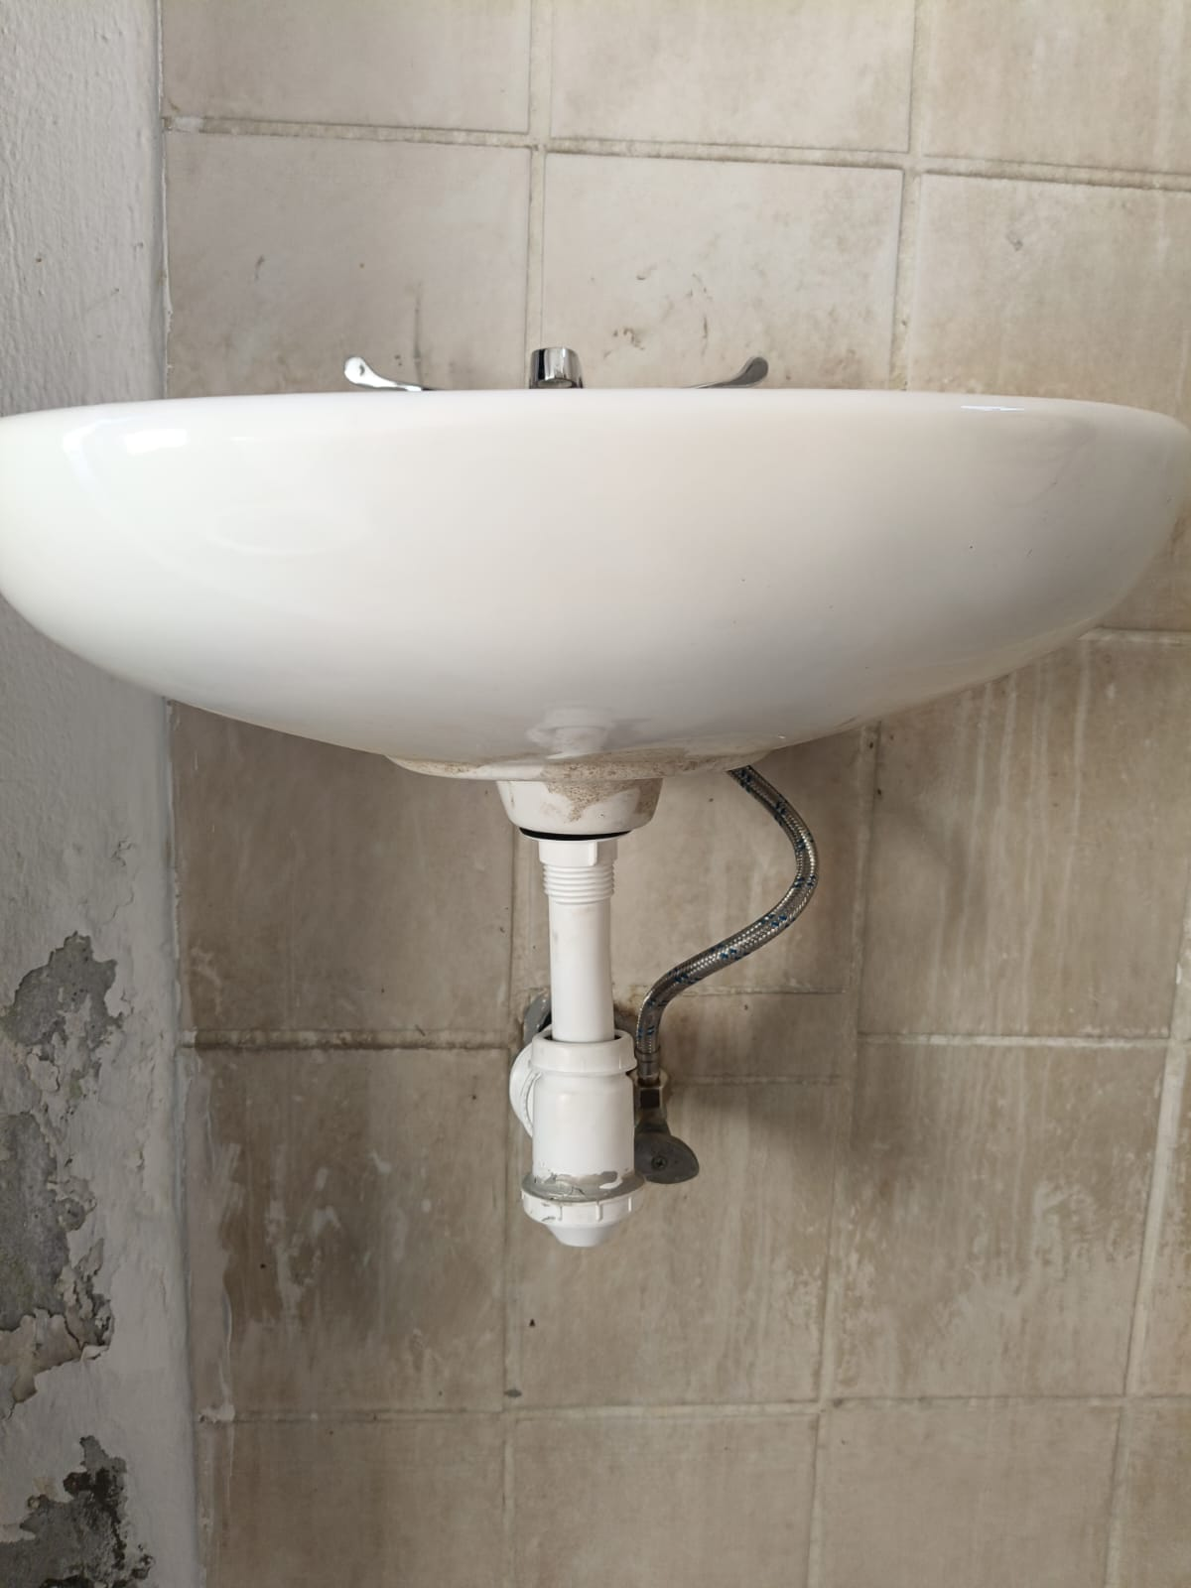
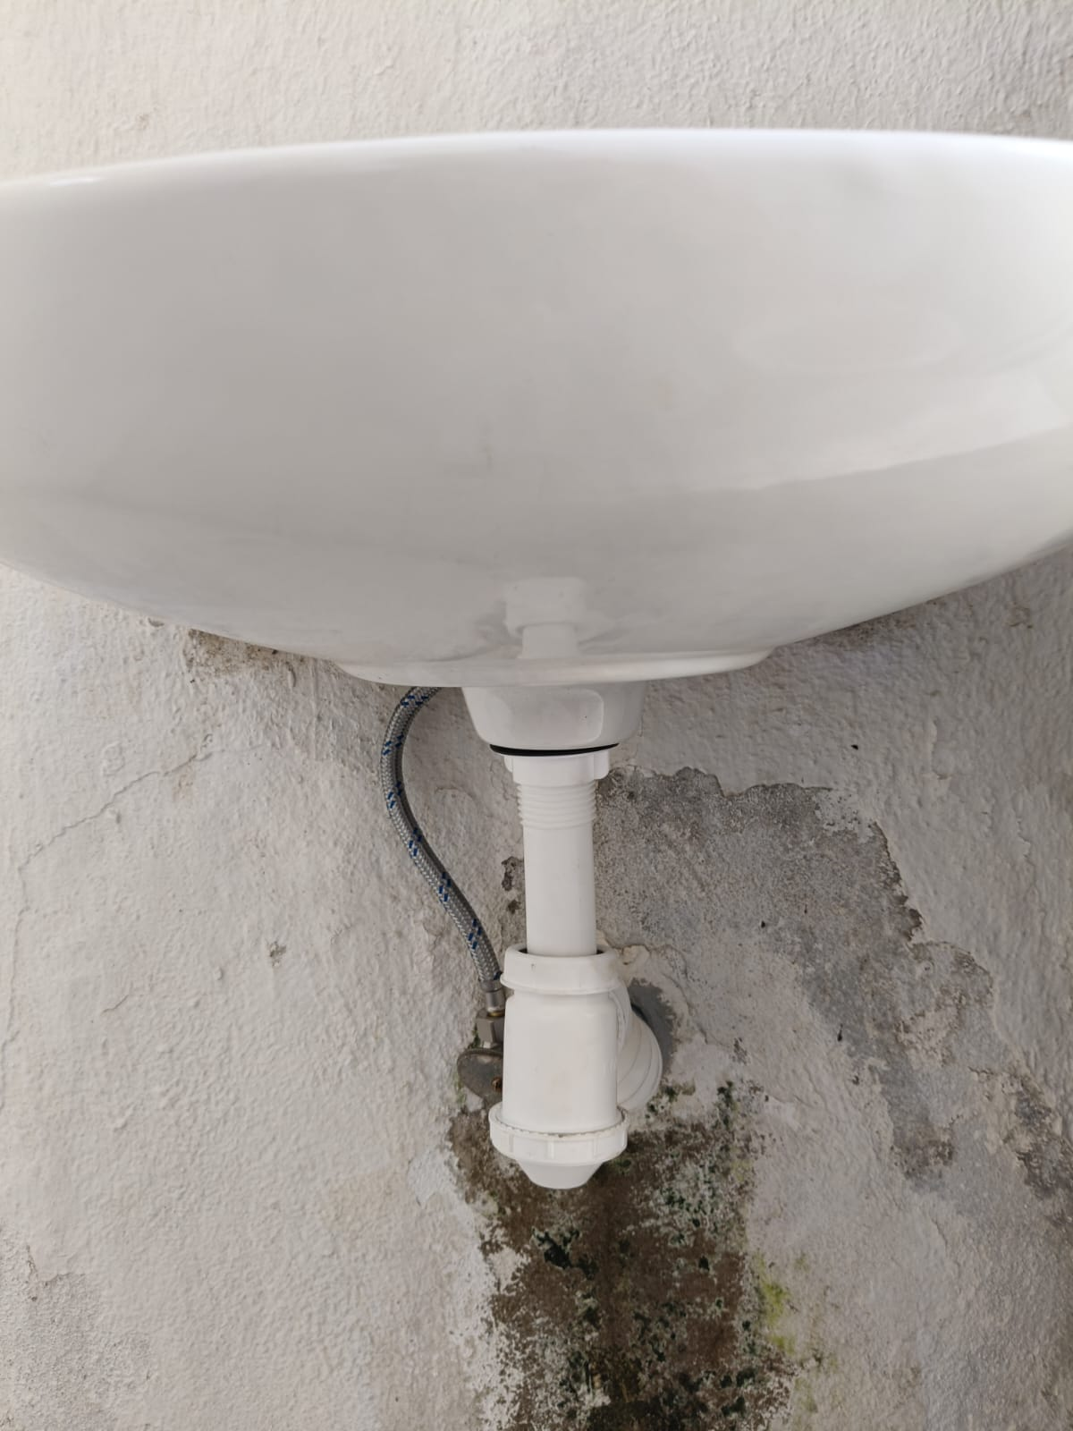
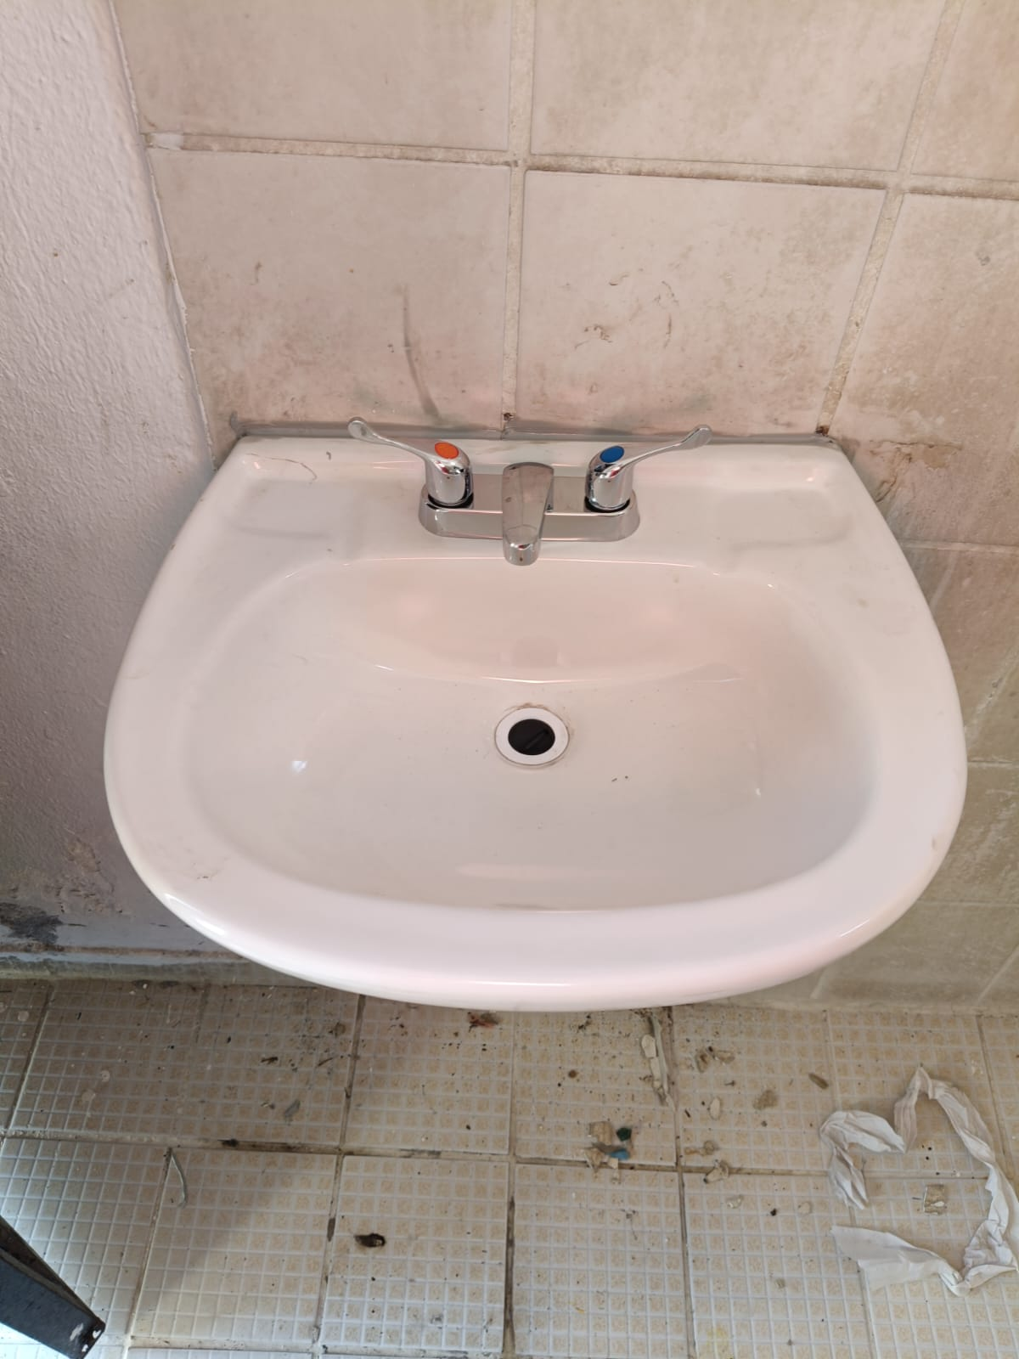
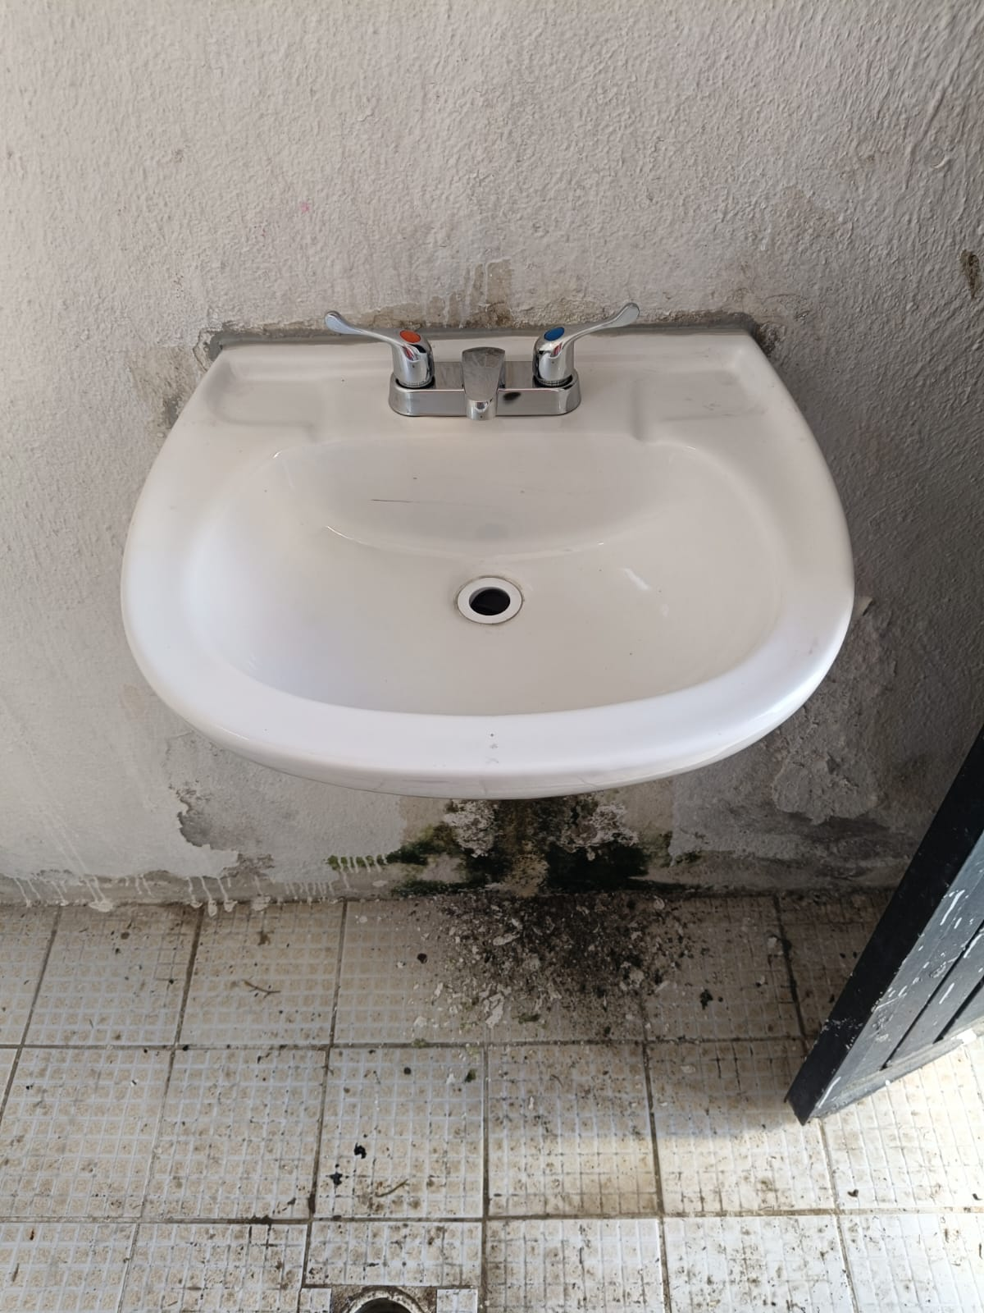
Fontaneria 5 de Diciembre
Title text addition
Title text addition
Title text addition
Title text addition
The user can demonstrate on a projector or computer, or print the presentation and make it film
The user can demonstrate on a projector or computer, or print the presentation and make it film
The user can demonstrate on a projector or computer, or print the presentation and make it film
The user can demonstrate on a projector or computer, or print the presentation and make it film

Slide 12
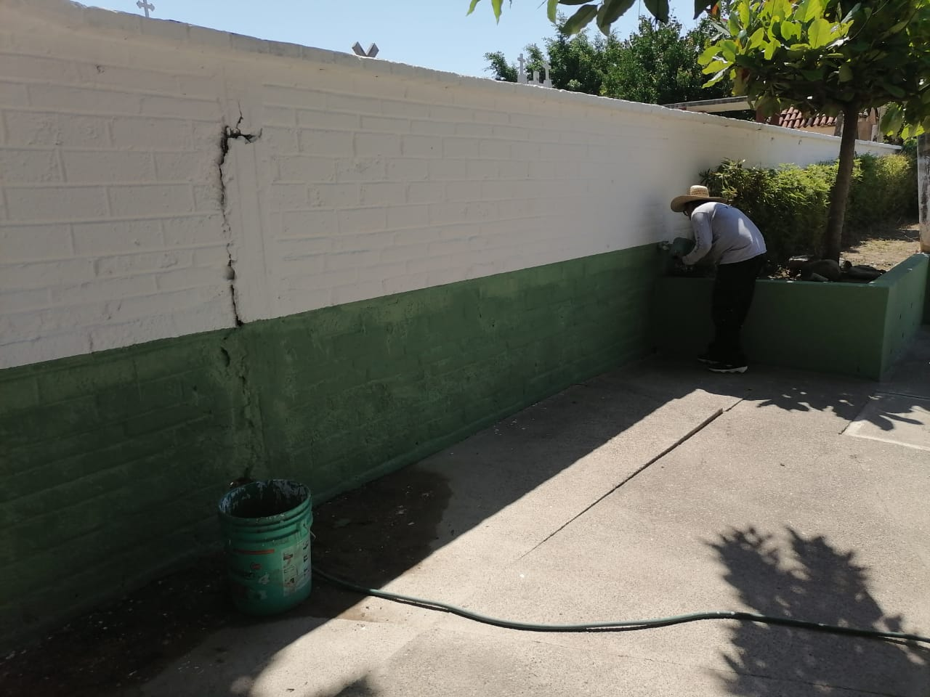
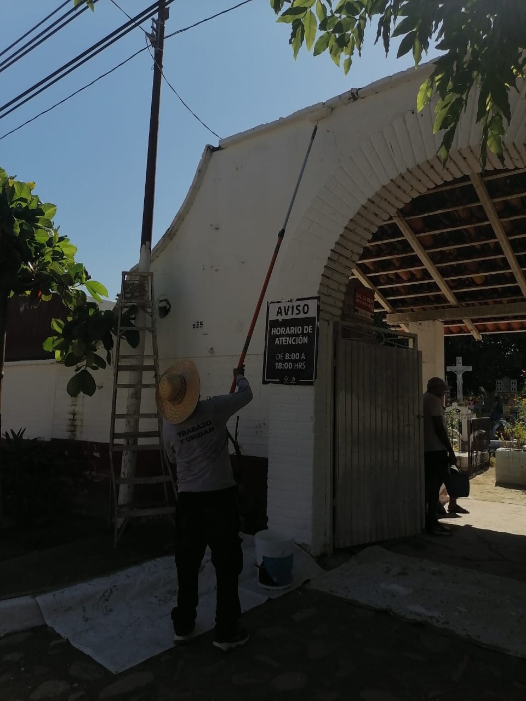
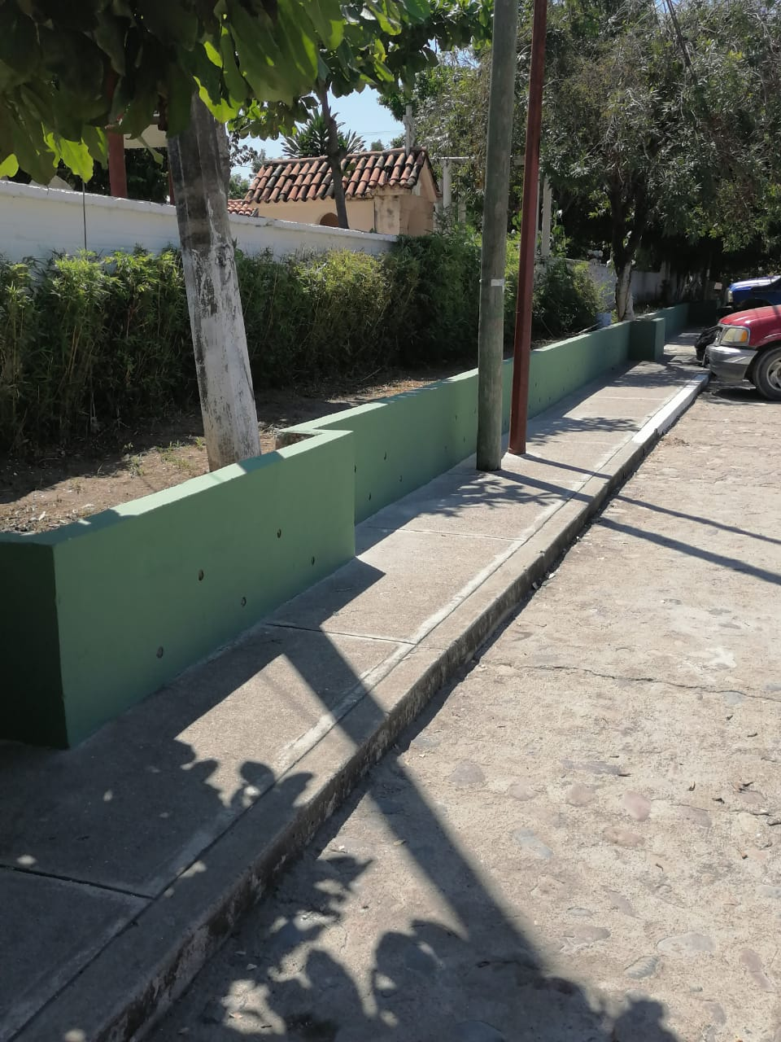
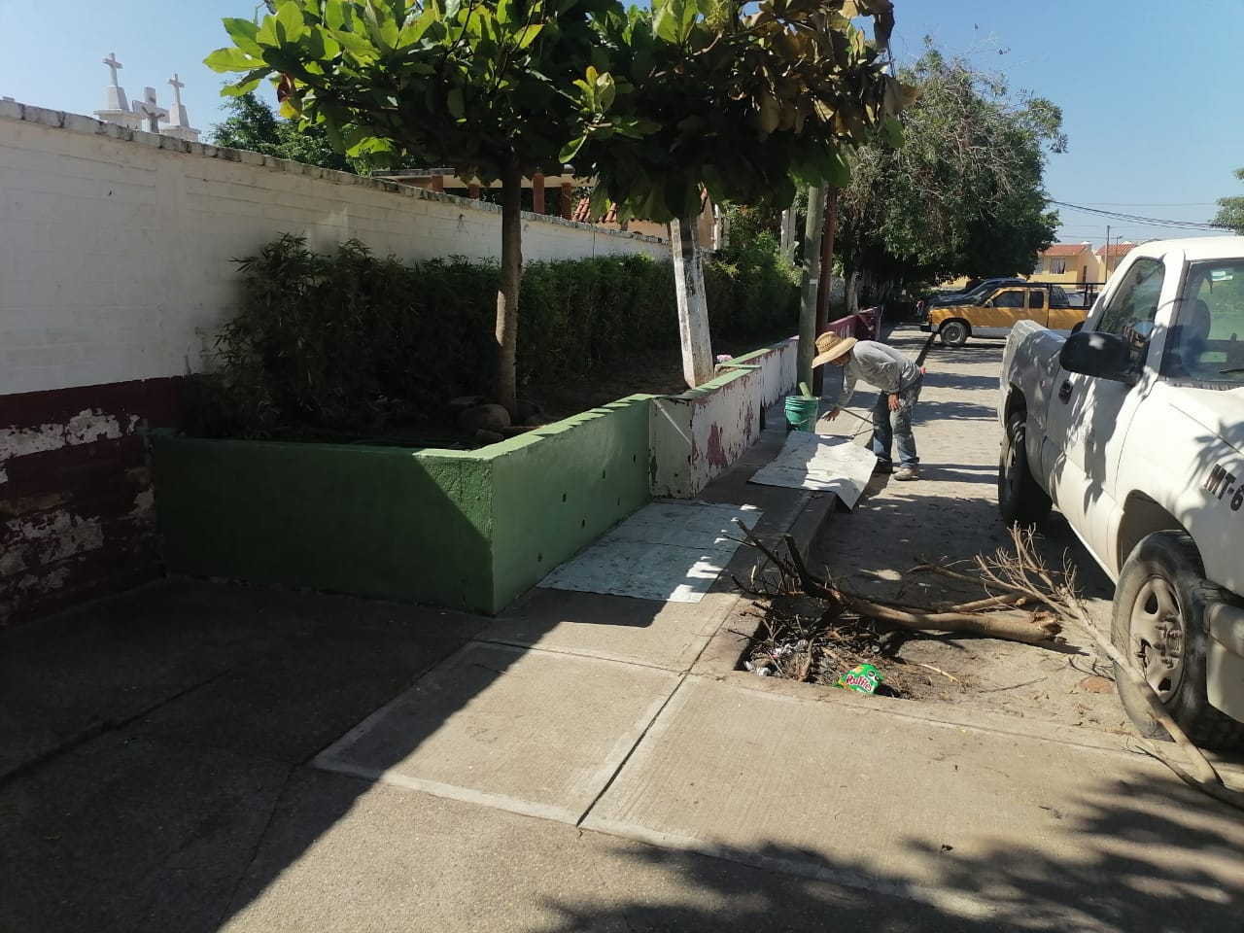
Panteon Ixtapa Pintura
Title text addition
Title text addition
Title text addition
Title text addition
The user can demonstrate on a projector or computer, or print the presentation and make it film
The user can demonstrate on a projector or computer, or print the presentation and make it film
The user can demonstrate on a projector or computer, or print the presentation and make it film
The user can demonstrate on a projector or computer, or print the presentation and make it film

Slide 13
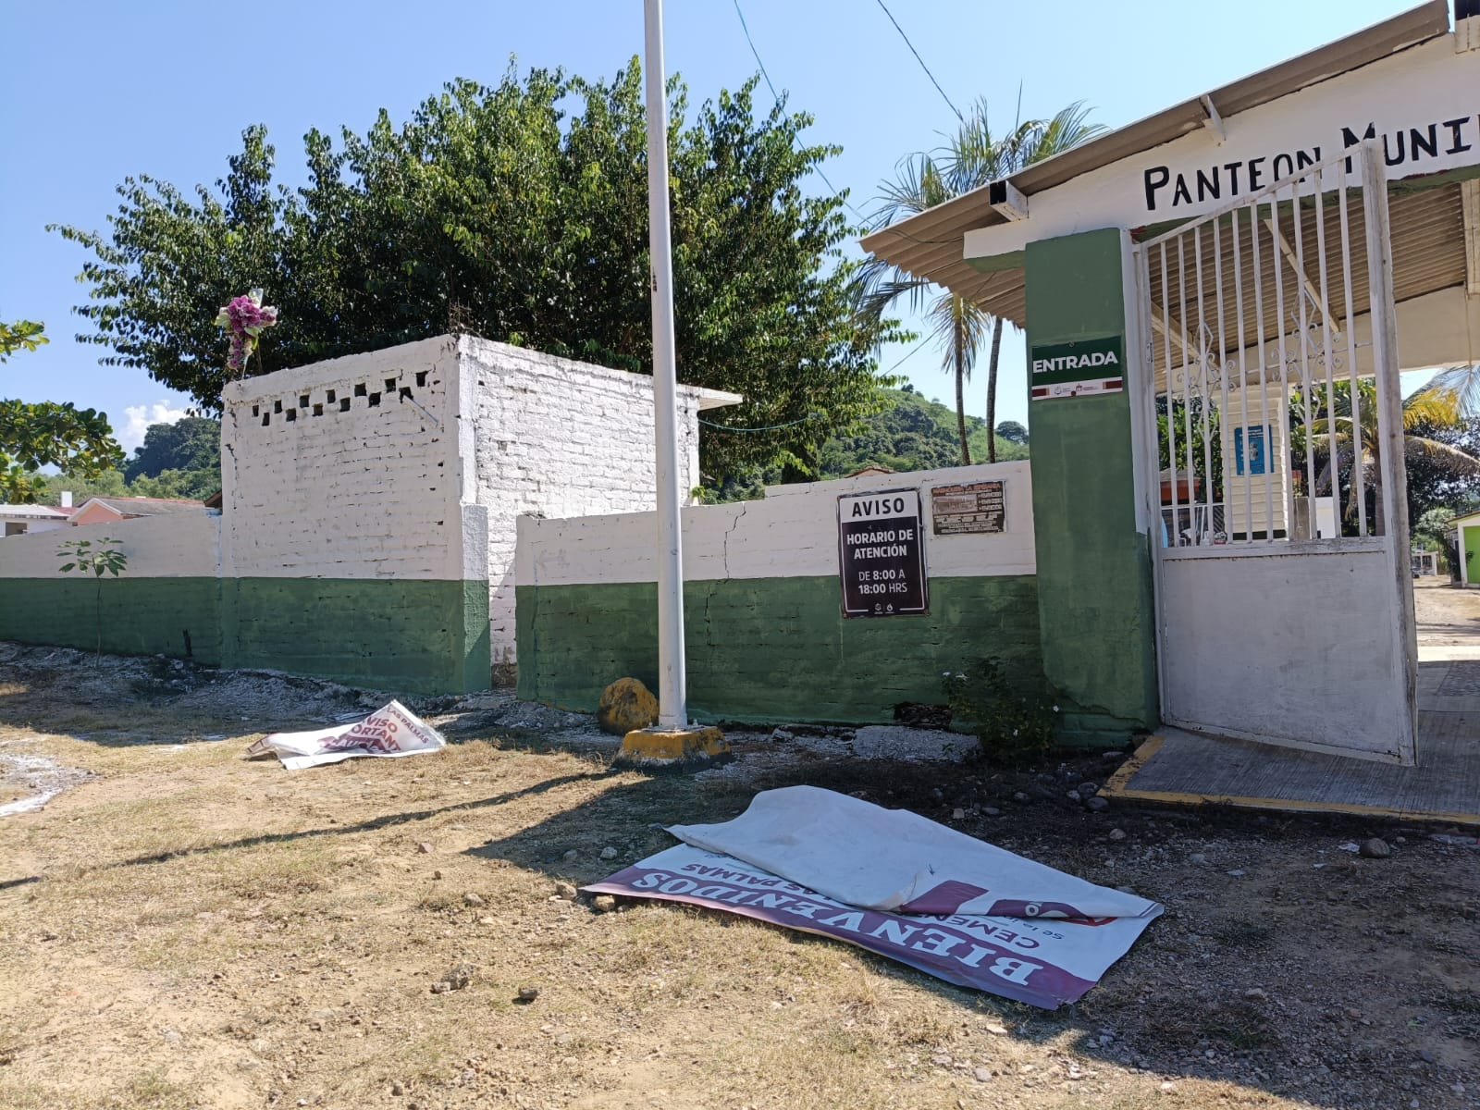
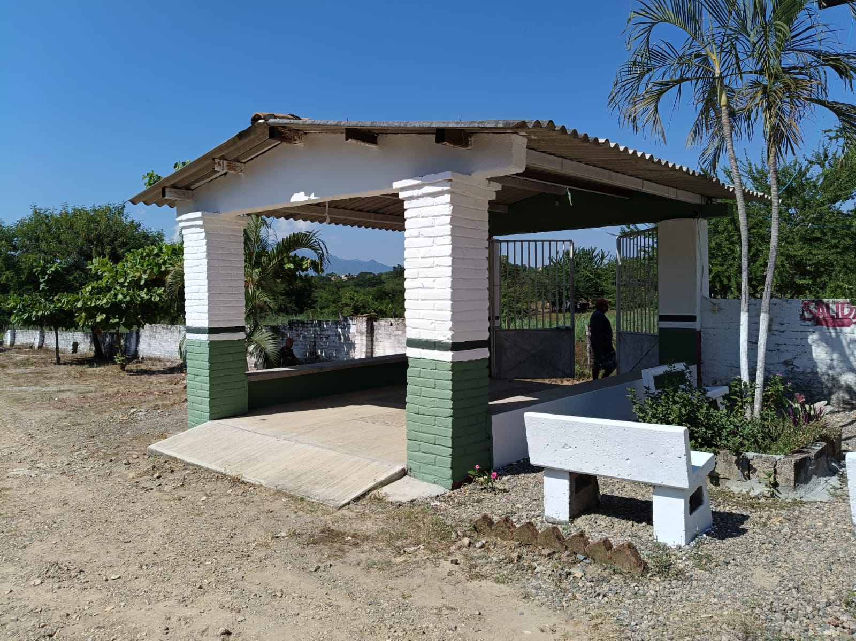
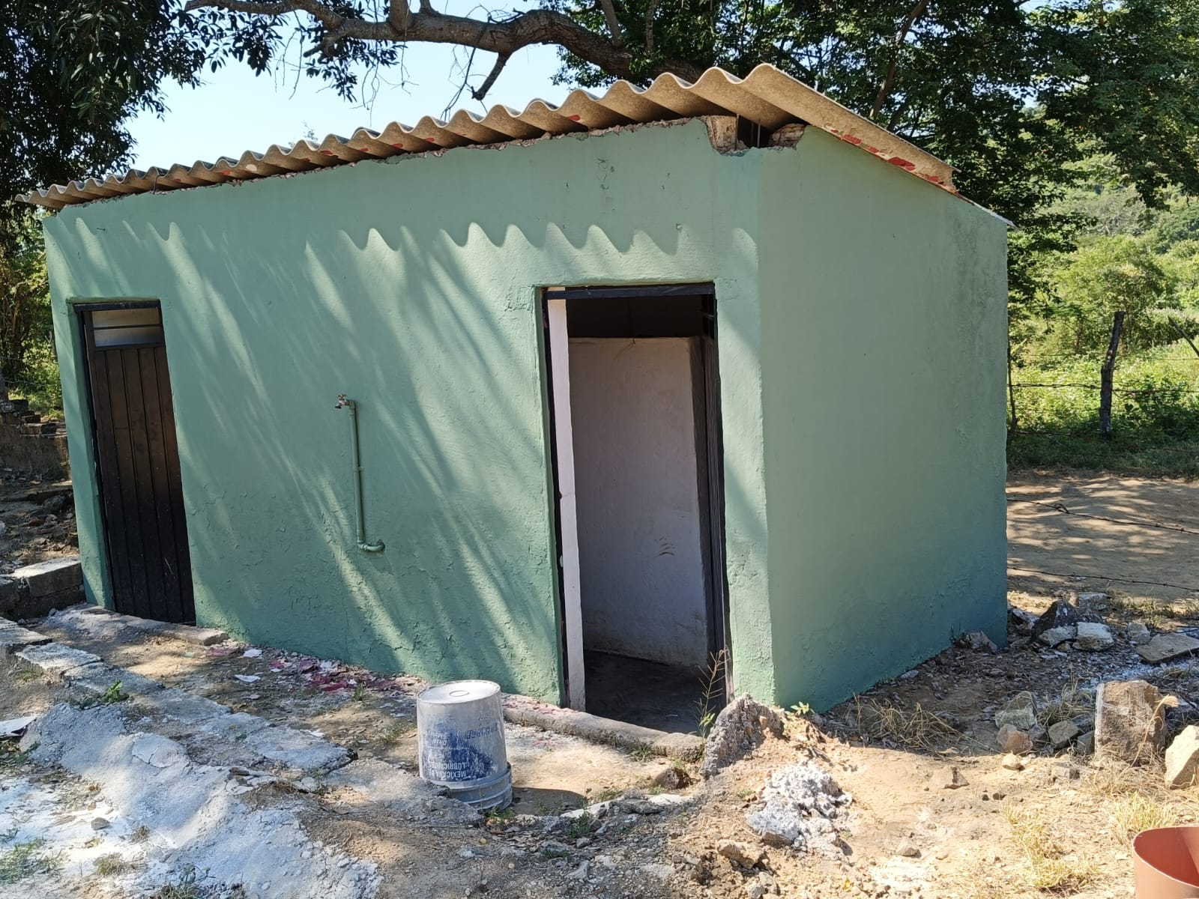
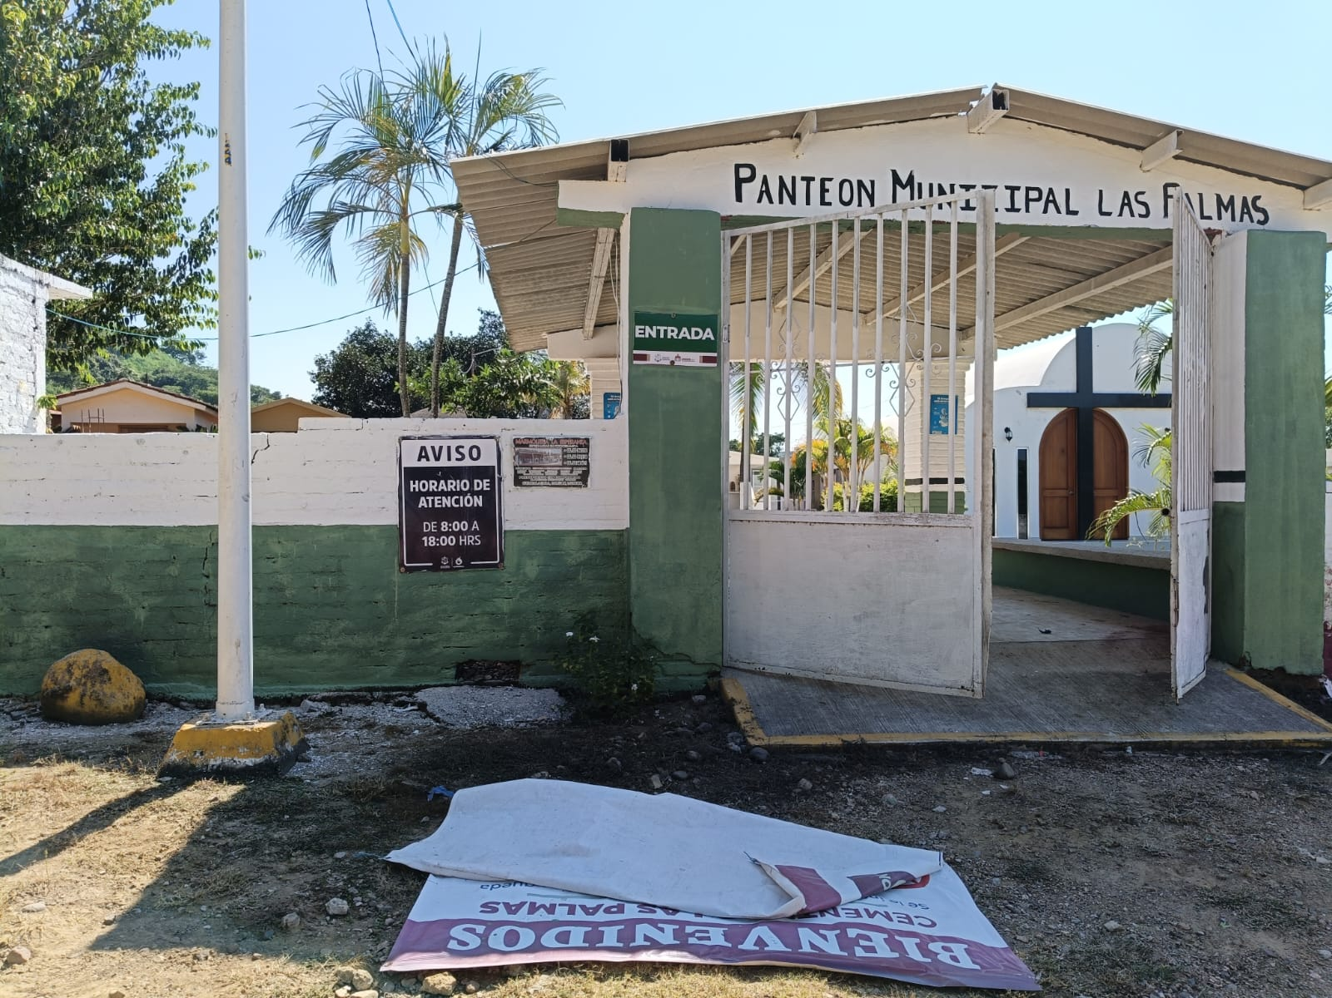
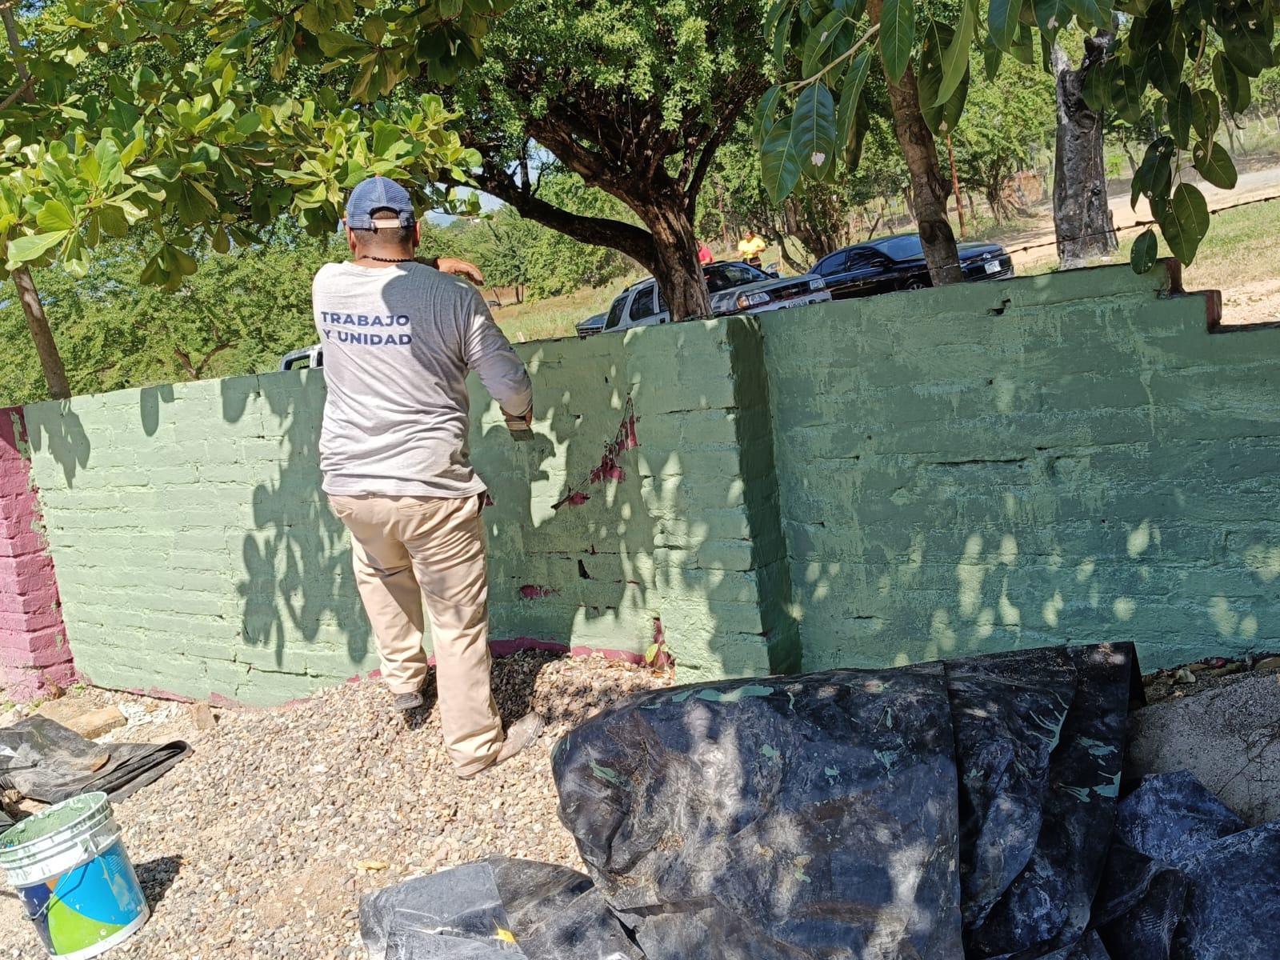
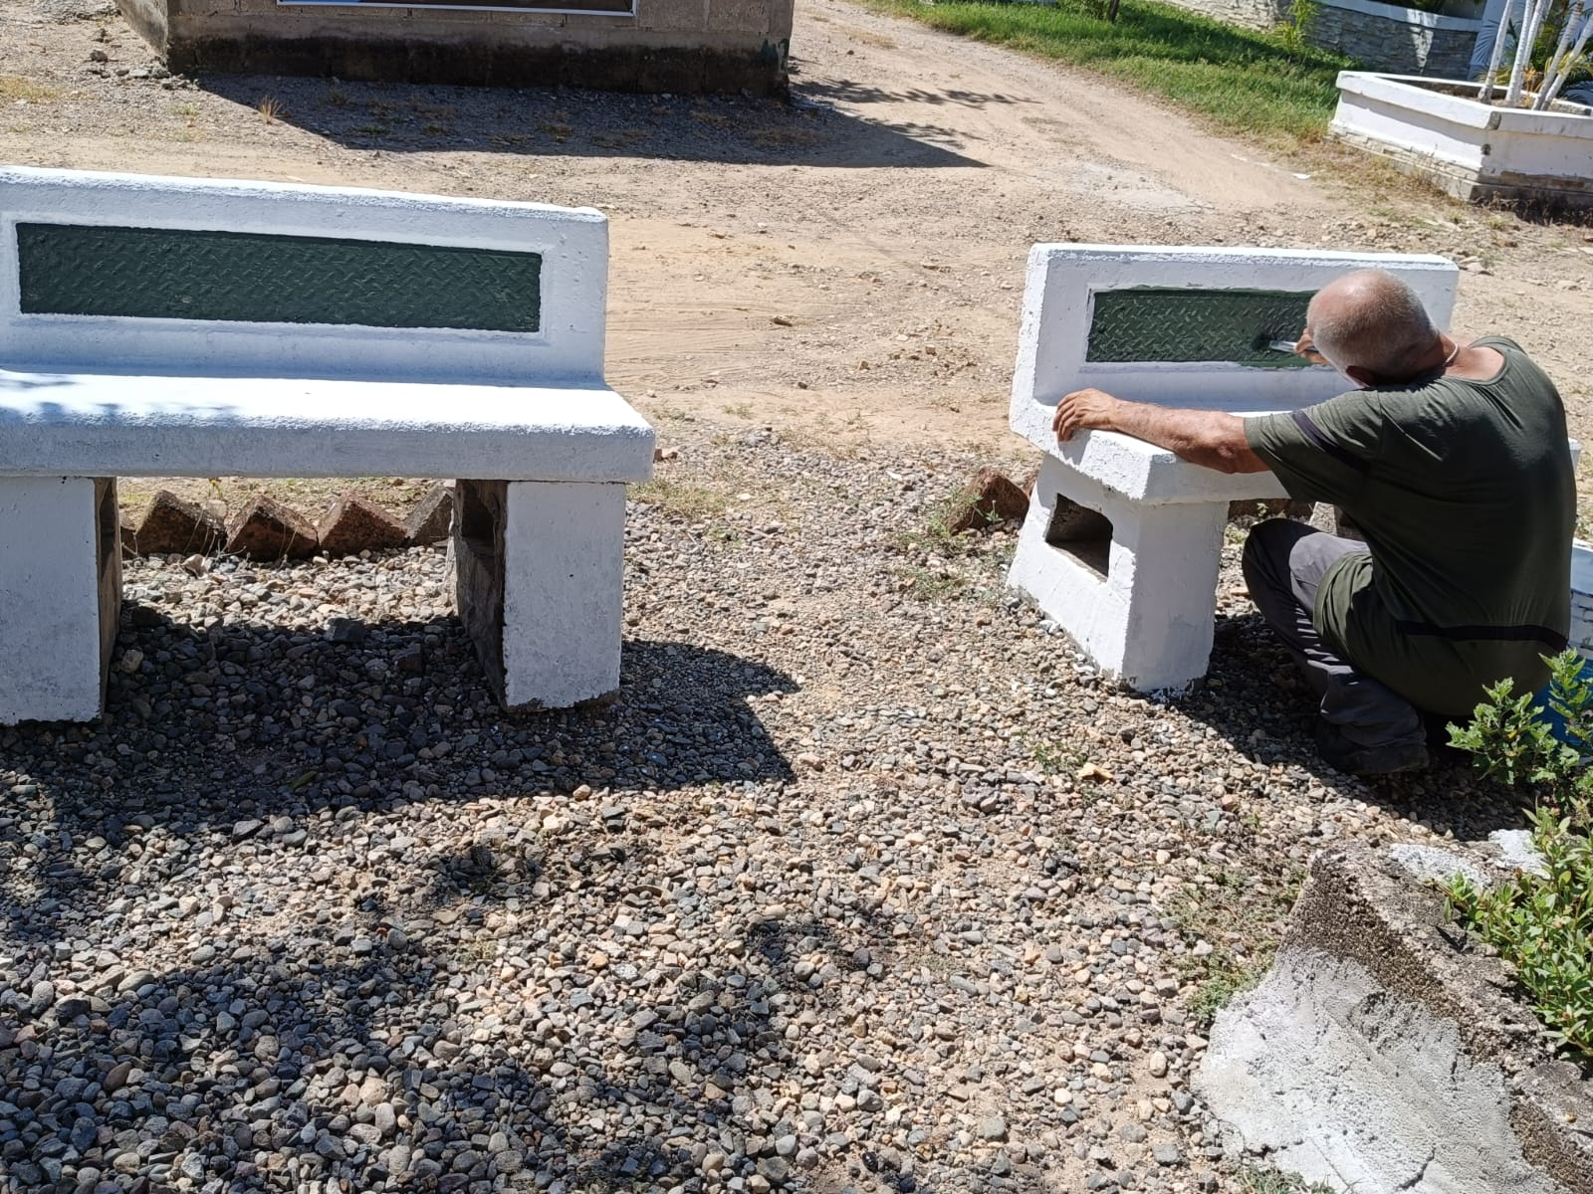
Panteon Las Palmas, Pintura
Title text addition
Title text addition
Title text addition
Title text addition
The user can demonstrate on a projector or computer, or print the presentation and make it film
The user can demonstrate on a projector or computer, or print the presentation and make it film
The user can demonstrate on a projector or computer, or print the presentation and make it film
The user can demonstrate on a projector or computer, or print the presentation and make it film

Slide 14
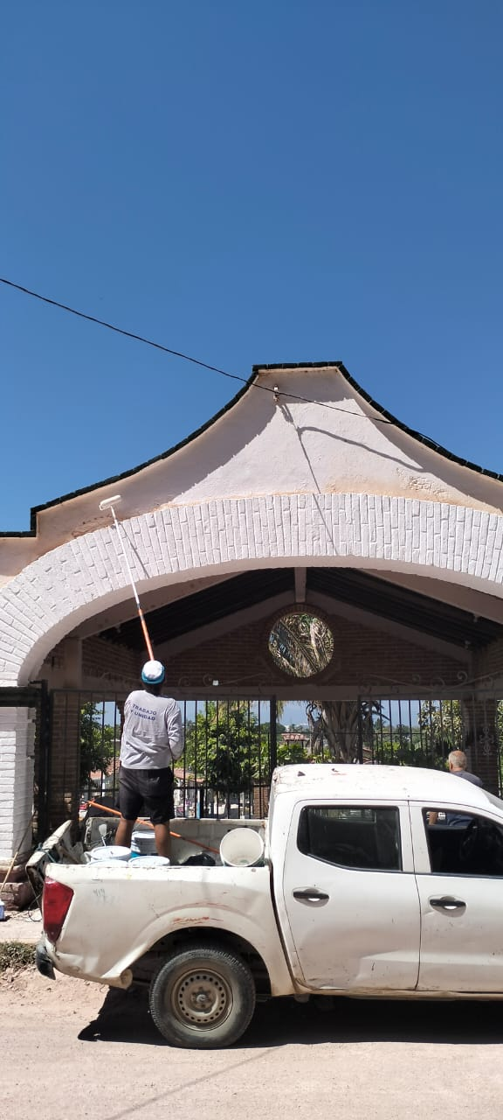
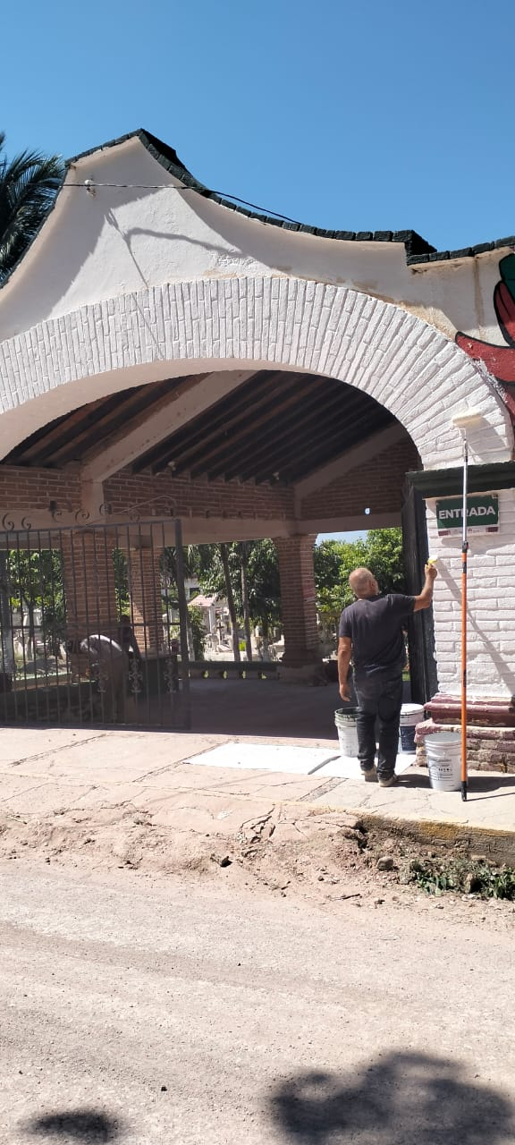
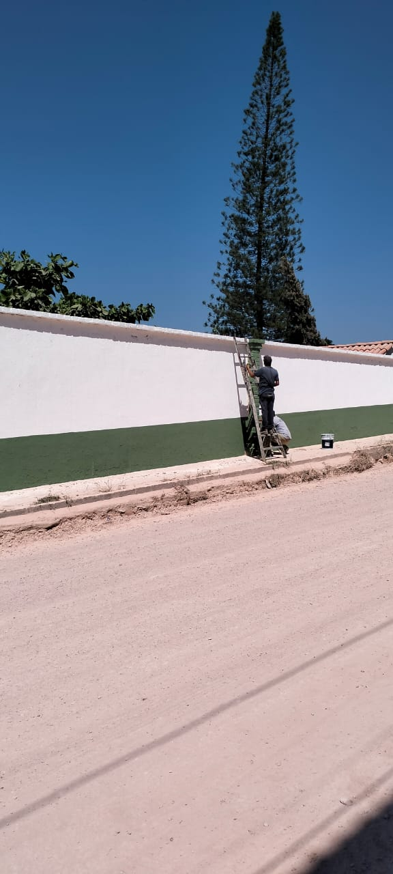
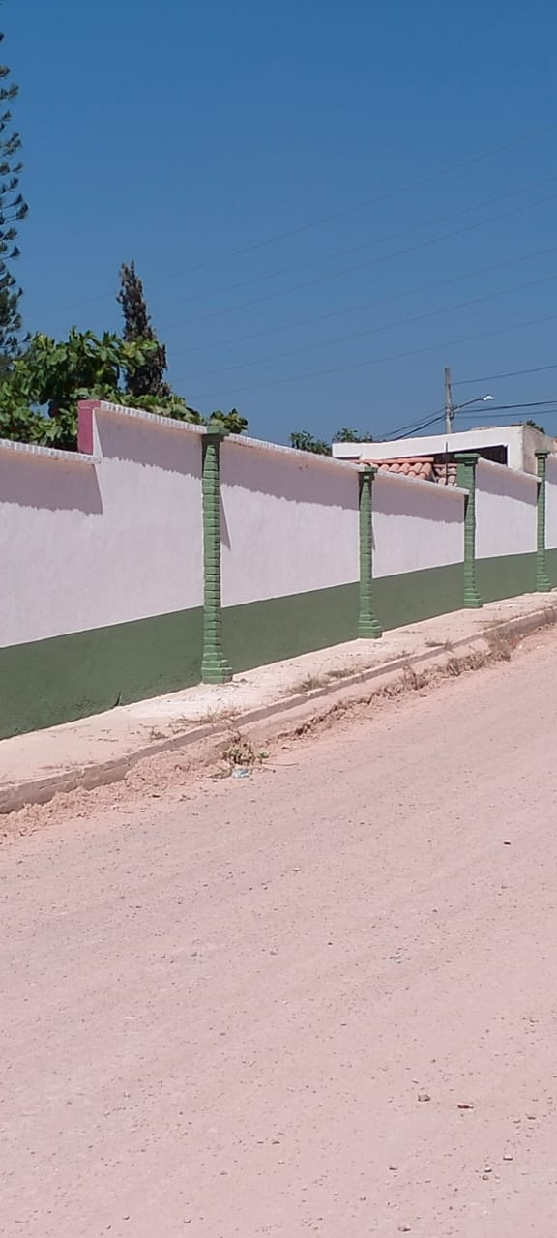
Panteon Ramblases Pintura
Title text addition
Title text addition
Title text addition
Title text addition
The user can demonstrate on a projector or computer, or print the presentation and make it film
The user can demonstrate on a projector or computer, or print the presentation and make it film
The user can demonstrate on a projector or computer, or print the presentation and make it film
The user can demonstrate on a projector or computer, or print the presentation and make it film

Slide 15
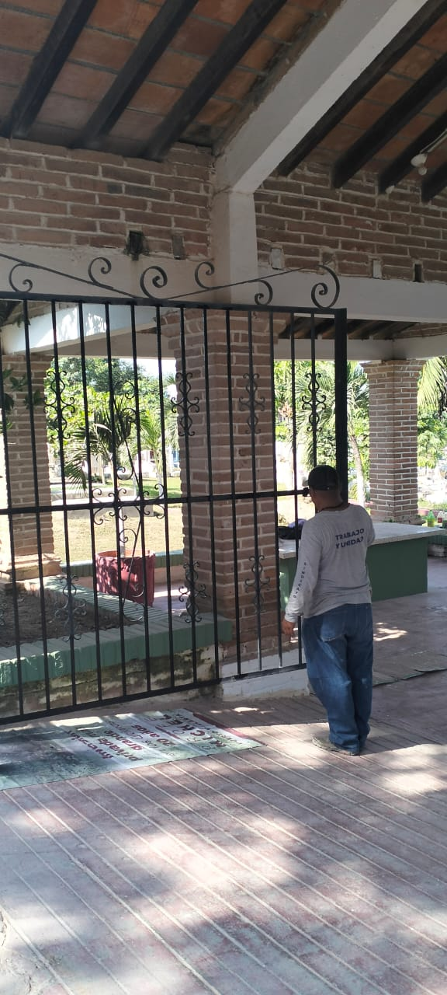
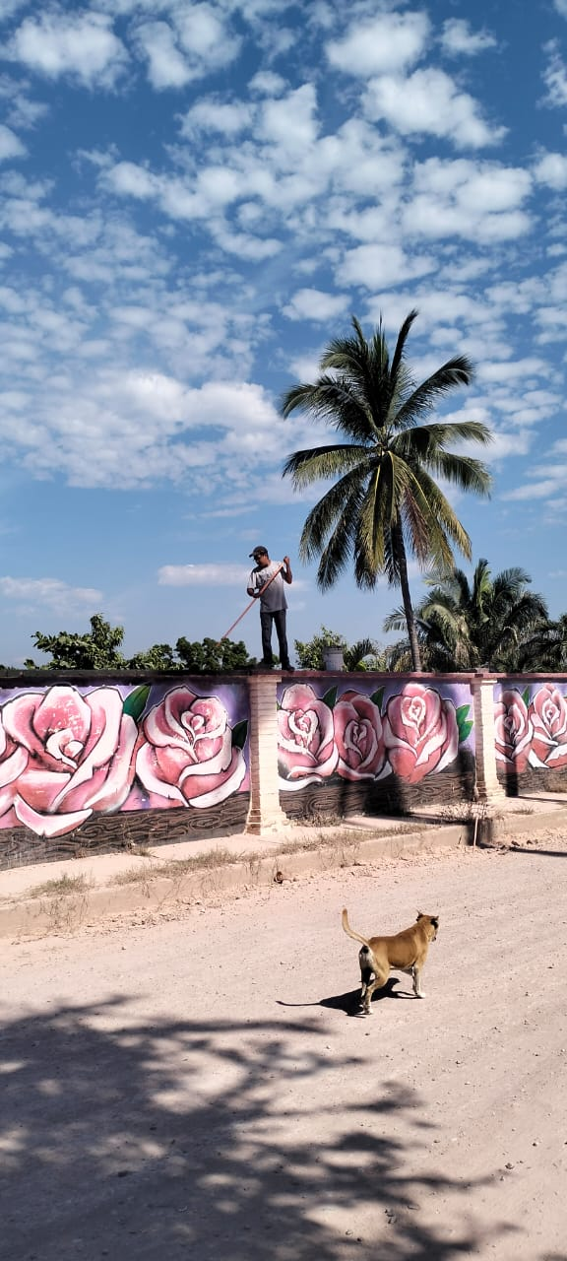
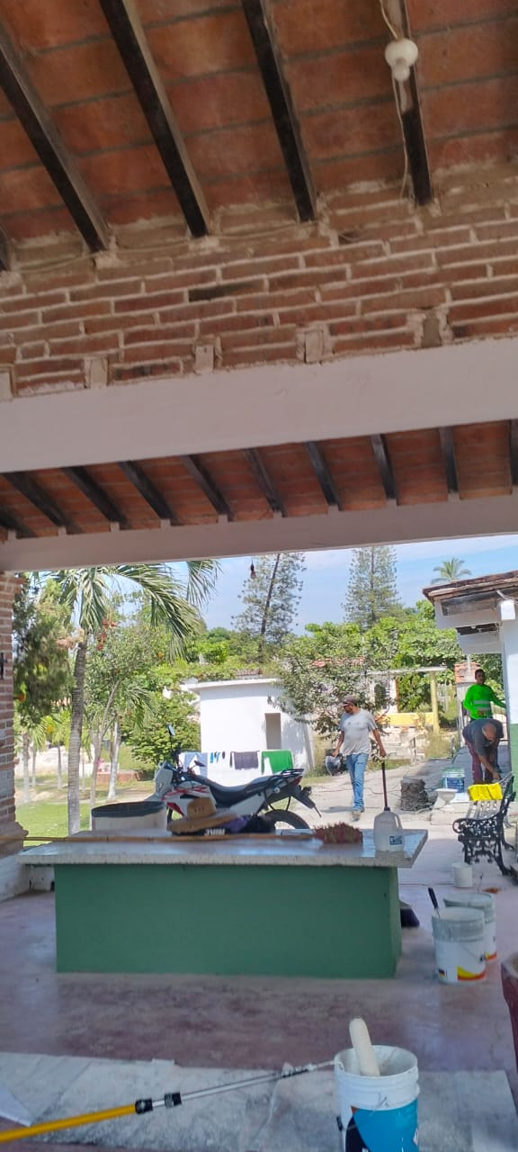
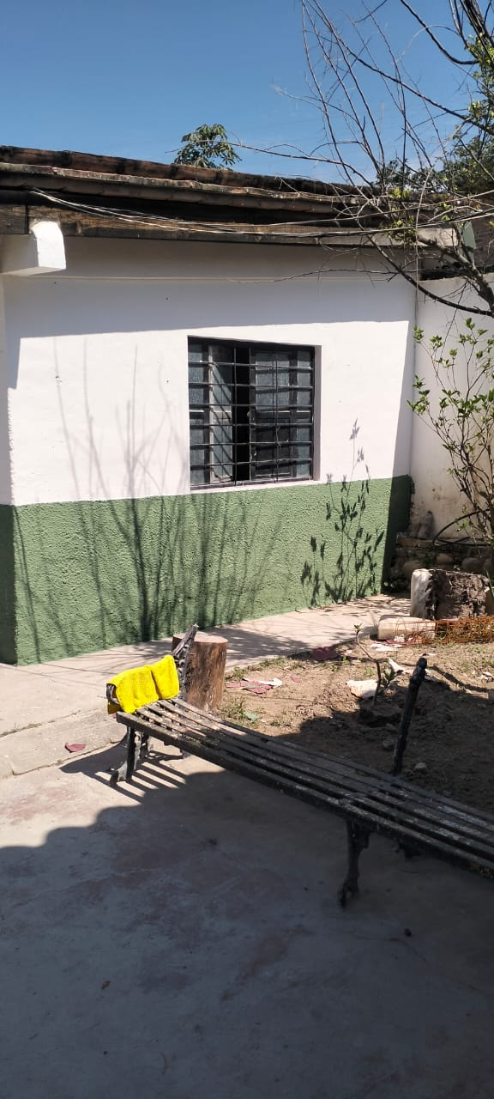
Panteon Ramblases Pintura
Title text addition
Title text addition
Title text addition
Title text addition
The user can demonstrate on a projector or computer, or print the presentation and make it film
The user can demonstrate on a projector or computer, or print the presentation and make it film
The user can demonstrate on a projector or computer, or print the presentation and make it film
The user can demonstrate on a projector or computer, or print the presentation and make it film

Slide 16
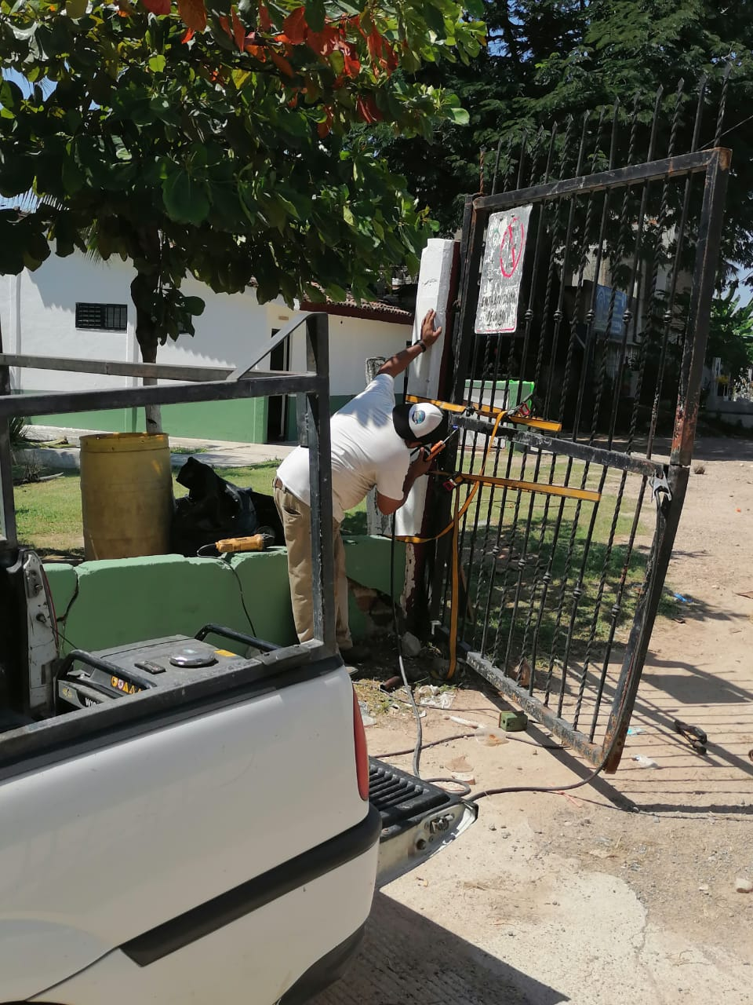
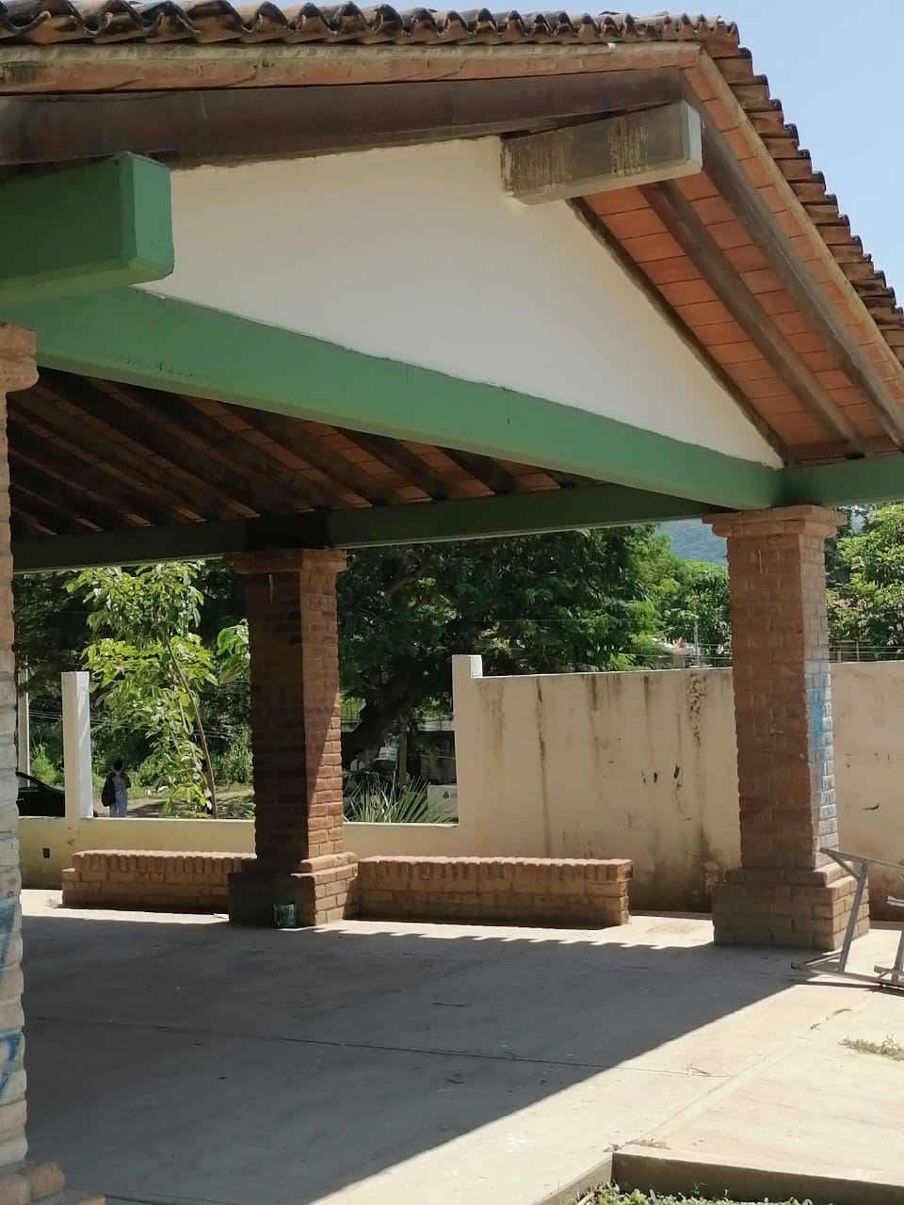
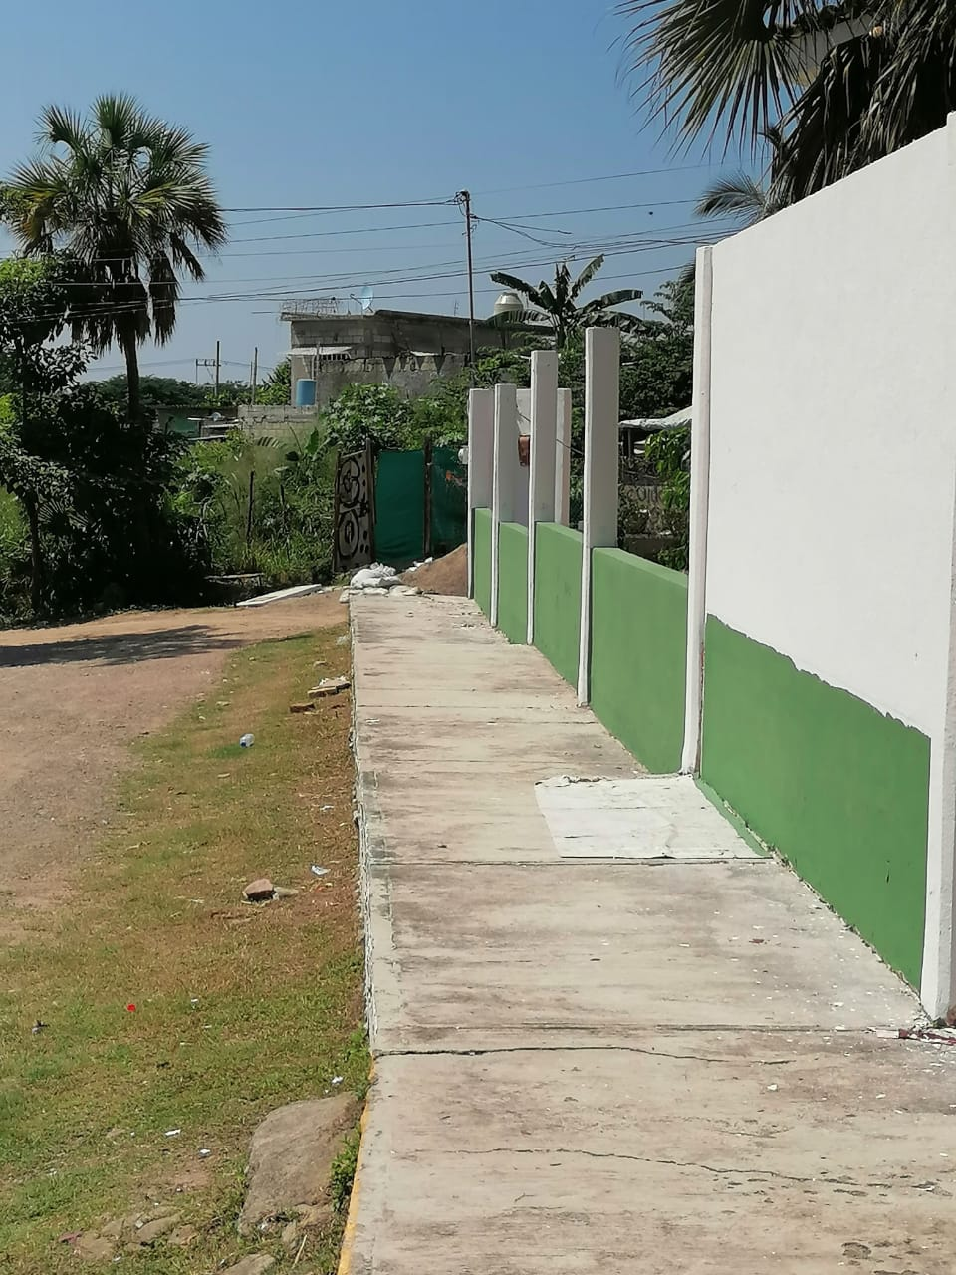
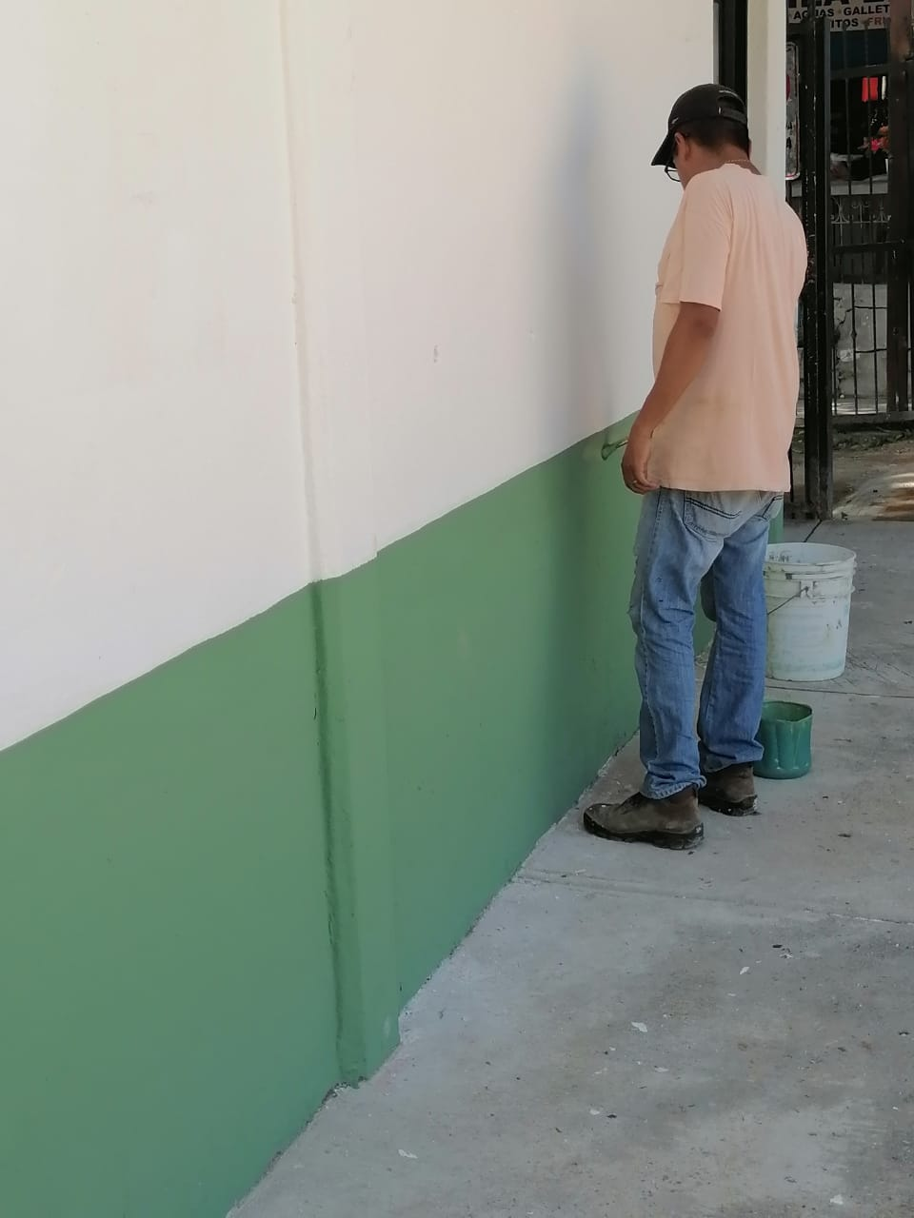
Panteon Progreso Pintura
Title text addition
Title text addition
Title text addition
Title text addition
The user can demonstrate on a projector or computer, or print the presentation and make it film
The user can demonstrate on a projector or computer, or print the presentation and make it film
The user can demonstrate on a projector or computer, or print the presentation and make it film
The user can demonstrate on a projector or computer, or print the presentation and make it film

Slide 17



Parque Lienal Fontaneria
Title text addition
Title text addition
Title text addition
Title text addition
The user can demonstrate on a projector or computer, or print the presentation and make it film
The user can demonstrate on a projector or computer, or print the presentation and make it film
The user can demonstrate on a projector or computer, or print the presentation and make it film
The user can demonstrate on a projector or computer, or print the presentation and make it film

Slide 18




Plaza pitillal Pintura
Title text addition
Title text addition
Title text addition
Title text addition
The user can demonstrate on a projector or computer, or print the presentation and make it film
The user can demonstrate on a projector or computer, or print the presentation and make it film
The user can demonstrate on a projector or computer, or print the presentation and make it film
The user can demonstrate on a projector or computer, or print the presentation and make it film

Slide 19
Presidencia centro Fontaneria
Title text addition
Title text addition
Title text addition
Title text addition
The user can demonstrate on a projector or computer, or print the presentation and make it film
The user can demonstrate on a projector or computer, or print the presentation and make it film
The user can demonstrate on a projector or computer, or print the presentation and make it film
The user can demonstrate on a projector or computer, or print the presentation and make it film

Slide 20



Reparacion de fuga de agua Presidencia
Title text addition
Title text addition
Title text addition
Title text addition
The user can demonstrate on a projector or computer, or print the presentation and make it film
The user can demonstrate on a projector or computer, or print the presentation and make it film
The user can demonstrate on a projector or computer, or print the presentation and make it film
The user can demonstrate on a projector or computer, or print the presentation and make it film

Slide 21



Reglamentos Archivos y patrimonios
Pintura
Title text addition
Title text addition
Title text addition
Title text addition
The user can demonstrate on a projector or computer, or print the presentation and make it film
The user can demonstrate on a projector or computer, or print the presentation and make it film
The user can demonstrate on a projector or computer, or print the presentation and make it film
The user can demonstrate on a projector or computer, or print the presentation and make it film

Slide 22



Sala Regidores A cambio de pastilla
Title text addition
Title text addition
Title text addition
Title text addition
The user can demonstrate on a projector or computer, or print the presentation and make it film
The user can demonstrate on a projector or computer, or print the presentation and make it film
The user can demonstrate on a projector or computer, or print the presentation and make it film
The user can demonstrate on a projector or computer, or print the presentation and make it film

Slide 23


Sala Regidores A instalo contacto
Title text addition
Title text addition
Title text addition
Title text addition
The user can demonstrate on a projector or computer, or print the presentation and make it film
The user can demonstrate on a projector or computer, or print the presentation and make it film
The user can demonstrate on a projector or computer, or print the presentation and make it film
The user can demonstrate on a projector or computer, or print the presentation and make it film

Slide 24


Sala Regidores C instalo contacto
Title text addition
Title text addition
Title text addition
Title text addition
The user can demonstrate on a projector or computer, or print the presentation and make it film
The user can demonstrate on a projector or computer, or print the presentation and make it film
The user can demonstrate on a projector or computer, or print the presentation and make it film
The user can demonstrate on a projector or computer, or print the presentation and make it film

Slide 25






Trabajos de pintura UMA
Title text addition
Title text addition
Title text addition
Title text addition
The user can demonstrate on a projector or computer, or print the presentation and make it film
The user can demonstrate on a projector or computer, or print the presentation and make it film
The user can demonstrate on a projector or computer, or print the presentation and make it film
The user can demonstrate on a projector or computer, or print the presentation and make it film

Slide 26
NOVIEMBRE

Slide 27



UMA trabajos de pintura
Title text addition
Title text addition
Title text addition
Title text addition
The user can demonstrate on a projector or computer, or print the presentation and make it film
The user can demonstrate on a projector or computer, or print the presentation and make it film
The user can demonstrate on a projector or computer, or print the presentation and make it film
The user can demonstrate on a projector or computer, or print the presentation and make it film

Slide 28



UMA trabajos Tablaroca
Title text addition
Title text addition
Title text addition
Title text addition
The user can demonstrate on a projector or computer, or print the presentation and make it film
The user can demonstrate on a projector or computer, or print the presentation and make it film
The user can demonstrate on a projector or computer, or print the presentation and make it film
The user can demonstrate on a projector or computer, or print the presentation and make it film

Slide 29


UMA Trabajos de electricidad
Title text addition
Title text addition
Title text addition
Title text addition
The user can demonstrate on a projector or computer, or print the presentation and make it film
The user can demonstrate on a projector or computer, or print the presentation and make it film
The user can demonstrate on a projector or computer, or print the presentation and make it film
The user can demonstrate on a projector or computer, or print the presentation and make it film

Slide 30



Reparacion de elevador
Title text addition
Title text addition
Title text addition
Title text addition
The user can demonstrate on a projector or computer, or print the presentation and make it film
The user can demonstrate on a projector or computer, or print the presentation and make it film
The user can demonstrate on a projector or computer, or print the presentation and make it film
The user can demonstrate on a projector or computer, or print the presentation and make it film

Slide 31



UMA instalacion de chapa
Title text addition
Title text addition
Title text addition
Title text addition
The user can demonstrate on a projector or computer, or print the presentation and make it film
The user can demonstrate on a projector or computer, or print the presentation and make it film
The user can demonstrate on a projector or computer, or print the presentation and make it film
The user can demonstrate on a projector or computer, or print the presentation and make it film

Slide 32



UMA instalacion de A/A
oficialia mayor
Title text addition
Title text addition
Title text addition
Title text addition
The user can demonstrate on a projector or computer, or print the presentation and make it film
The user can demonstrate on a projector or computer, or print the presentation and make it film
The user can demonstrate on a projector or computer, or print the presentation and make it film
The user can demonstrate on a projector or computer, or print the presentation and make it film

Slide 33



UMA material electrico
Title text addition
Title text addition
Title text addition
Title text addition
The user can demonstrate on a projector or computer, or print the presentation and make it film
The user can demonstrate on a projector or computer, or print the presentation and make it film
The user can demonstrate on a projector or computer, or print the presentation and make it film
The user can demonstrate on a projector or computer, or print the presentation and make it film

Slide 34


UMA Jefatura instalacion A/A
Title text addition
Title text addition
Title text addition
Title text addition
The user can demonstrate on a projector or computer, or print the presentation and make it film
The user can demonstrate on a projector or computer, or print the presentation and make it film
The user can demonstrate on a projector or computer, or print the presentation and make it film
The user can demonstrate on a projector or computer, or print the presentation and make it film

Slide 35




Pintura COMUDIS, COMUSIDA y Servicios Medicos.
Title text addition
Title text addition
Title text addition
Title text addition
The user can demonstrate on a projector or computer, or print the presentation and make it film
The user can demonstrate on a projector or computer, or print the presentation and make it film
The user can demonstrate on a projector or computer, or print the presentation and make it film
The user can demonstrate on a projector or computer, or print the presentation and make it film

Slide 36



Secundaria Mojoneras mano de obra
Title text addition
Title text addition
Title text addition
Title text addition
The user can demonstrate on a projector or computer, or print the presentation and make it film
The user can demonstrate on a projector or computer, or print the presentation and make it film
The user can demonstrate on a projector or computer, or print the presentation and make it film
The user can demonstrate on a projector or computer, or print the presentation and make it film

Slide 37

Secretaria General instalacion de taza de baño
Title text addition
Title text addition
Title text addition
Title text addition
The user can demonstrate on a projector or computer, or print the presentation and make it film
The user can demonstrate on a projector or computer, or print the presentation and make it film
The user can demonstrate on a projector or computer, or print the presentation and make it film
The user can demonstrate on a projector or computer, or print the presentation and make it film

Slide 38



Regidores B fontaneria
Title text addition
Title text addition
Title text addition
Title text addition
The user can demonstrate on a projector or computer, or print the presentation and make it film
The user can demonstrate on a projector or computer, or print the presentation and make it film
The user can demonstrate on a projector or computer, or print the presentation and make it film
The user can demonstrate on a projector or computer, or print the presentation and make it film

Slide 39


Reparacion fontaneria COMUDIS
Title text addition
Title text addition
Title text addition
Title text addition
The user can demonstrate on a projector or computer, or print the presentation and make it film
The user can demonstrate on a projector or computer, or print the presentation and make it film
The user can demonstrate on a projector or computer, or print the presentation and make it film
The user can demonstrate on a projector or computer, or print the presentation and make it film

Slide 40



Puente peatonal Buenos Aires
Title text addition
Title text addition
Title text addition
Title text addition
The user can demonstrate on a projector or computer, or print the presentation and make it film
The user can demonstrate on a projector or computer, or print the presentation and make it film
The user can demonstrate on a projector or computer, or print the presentation and make it film
The user can demonstrate on a projector or computer, or print the presentation and make it film

Slide 41


Puente camarones pintura
Title text addition
Title text addition
Title text addition
Title text addition
The user can demonstrate on a projector or computer, or print the presentation and make it film
The user can demonstrate on a projector or computer, or print the presentation and make it film
The user can demonstrate on a projector or computer, or print the presentation and make it film
The user can demonstrate on a projector or computer, or print the presentation and make it film

Slide 42



Prevencion del delito
Trabajos de electicidad
Title text addition
Title text addition
Title text addition
Title text addition
The user can demonstrate on a projector or computer, or print the presentation and make it film
The user can demonstrate on a projector or computer, or print the presentation and make it film
The user can demonstrate on a projector or computer, or print the presentation and make it film
The user can demonstrate on a projector or computer, or print the presentation and make it film

Slide 43



Presidencia pintura en ventanas
Title text addition
Title text addition
Title text addition
Title text addition
The user can demonstrate on a projector or computer, or print the presentation and make it film
The user can demonstrate on a projector or computer, or print the presentation and make it film
The user can demonstrate on a projector or computer, or print the presentation and make it film
The user can demonstrate on a projector or computer, or print the presentation and make it film

Slide 44



Presidencia, trabajo de fontaneria
Title text addition
Title text addition
Title text addition
Title text addition
The user can demonstrate on a projector or computer, or print the presentation and make it film
The user can demonstrate on a projector or computer, or print the presentation and make it film
The user can demonstrate on a projector or computer, or print the presentation and make it film
The user can demonstrate on a projector or computer, or print the presentation and make it film

Slide 45



Plaza pitillal trabajos de pintura
Title text addition
Title text addition
Title text addition
Title text addition
The user can demonstrate on a projector or computer, or print the presentation and make it film
The user can demonstrate on a projector or computer, or print the presentation and make it film
The user can demonstrate on a projector or computer, or print the presentation and make it film
The user can demonstrate on a projector or computer, or print the presentation and make it film

Slide 46



Plaza Ixtapa, trabajos de pintura
Title text addition
Title text addition
Title text addition
Title text addition
The user can demonstrate on a projector or computer, or print the presentation and make it film
The user can demonstrate on a projector or computer, or print the presentation and make it film
The user can demonstrate on a projector or computer, or print the presentation and make it film
The user can demonstrate on a projector or computer, or print the presentation and make it film

Slide 47


Parque Hidalgo pintura
Title text addition
Title text addition
Title text addition
Title text addition
The user can demonstrate on a projector or computer, or print the presentation and make it film
The user can demonstrate on a projector or computer, or print the presentation and make it film
The user can demonstrate on a projector or computer, or print the presentation and make it film
The user can demonstrate on a projector or computer, or print the presentation and make it film

Slide 48






Parque Hidalgo Pintura
Title text addition
Title text addition
Title text addition
Title text addition
The user can demonstrate on a projector or computer, or print the presentation and make it film
The user can demonstrate on a projector or computer, or print the presentation and make it film
The user can demonstrate on a projector or computer, or print the presentation and make it film
The user can demonstrate on a projector or computer, or print the presentation and make it film

Slide 49



Panteon Progreso reparacion de baños

Slide 50



Mercado Emiliano Zapata

Slide 51



Malecon reparacion electrica

Slide 52



Laguna del coapinole. Pintura

Slide 53

Instalacion de lactario

Slide 54



Faro calle Matamoros Limpieza

Slide 55




Cocoteros trabajos de pintura

Slide 56


Cocoteros instalacion de 11 focos

Slide 57



Reparacion Canchas Ramblases

Slide 58



Pinturas Canchas Ramblases

Slide 59



Baños Presidencia

Slide 60



Agencia Municipal Mojoneras

Slide 61
DICIEMBRE

Slide 62




Las Palmas, trabajo de pintura

Slide 63


Casa Tucan Los Poetas Pintura

Slide 64


Please enter the title

Slide 65


Soldadura de porton

Slide 66



Taller municipal trabajos de pintura

Slide 67



UMA trabajos de tablaroca

Slide 68


Tablaroca en proyectos estrategicos

Slide 69


UMA sala de juntas contactos

Slide 70


Servicios Medicos El Coapinole

Slide 71
SERVICIOS REALIZADOS POR LA DIRECCION DE MANTENIMIENTO DE BIENES E INTENDENCIA
SERVICIOS: Pintura de panteones, Agencias municipales, Instalacion y cambio de chapas, electricidad, trabajos de albañileria, herreria, tablaroca, instalaciones de A/A, movimiento de vayas, instalacion de contactos, materiales, trabajos de soldadura, reparacion de baños, mantenimiento de puente peatonal, reparacion de fontaneria.
SOLICITADOS VIA OFICIO POR DIFERENTES DEPENDENCIAS, DE OCTUBRE-DICIEMBRE 2024.

Slide 72
 | RECIBIDOS | REALIZADOS | PENDIENTES
VIA OFICIO | 105 | 87 | 18
ORDEN DE SERVICIO | 211 | 211 | 0
OCTUBRE | 34 | 28 | 6
NOVIEMBRE | 47 | 42 | 5
DICIEMBRE | 24 | 17 | 7
TOTAL | 316 | 298

